Slide 1

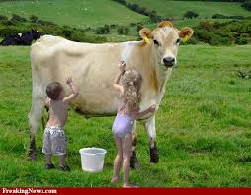
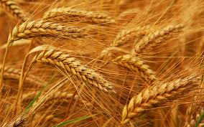
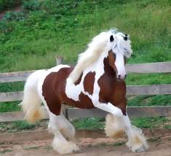
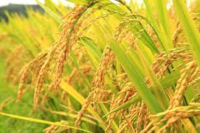
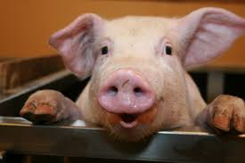
History of Genetic Manipulation
Cats, horses, cattle, corn, wheat, rice, pigs, etc. – centuries of selective breeding and active selection have greatly changed characteristics present in the “wild” states.

Slide 2
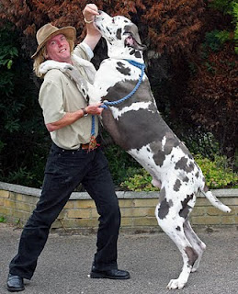
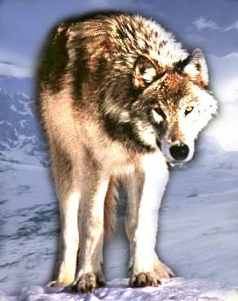

History of Genetic Manipulation
First divergence from wolf occurred ~40,000 years ago, rapid phenotypic changes seen ~15,000 ago with human settlements in stable agricultural communities (Vila et al., Science 1997:
Vol. 276 ,1687-1689 )
Other examples????

Slide 3
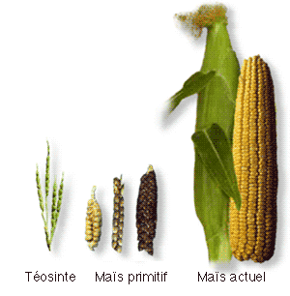
Mayan development of corn from teosinte grass
http://teosinte.wisc.edu/questions.html
Teosinte is the common name for a group of four annual and perennial species of the genus Zea native to Mexico and Central America (Doebley 1990; Sanchez et al. 1998; Wilkes 1967). One form of teosinte, known as Zeo mays ssp. parviglumis, shares a particularly close genetic relationship with maize and available evidence indicates that it is the direct ancestor of maize (Doebley 1990; Matsuoka et al. 2002). Maize was domesticated between 6,000 and 10,000 years ago in the valleys of southwestern Mexico.

Slide 4
Questions to consider
1) What defines a desirable trait?
2) How does one “breed in” these features?
3) Are domesticated versions of dogs, horses, corn, etc. “genetically modified”?
4) What is the underlying genetic basis for the physical and behavioral landmarks of domestication? Is there a “cost”?

Slide 5
5) What Makes Genetic Engineering Different from Selective Breeding?
Execution and Outcome

Slide 6
Recombinant DNA technology provides means of selecting when & where genomes are combined.
Outcomes (at least at the DNA level) are predictable and may include the combination of DNAs from mixed organisms.

Slide 7
Question
Do “mixed (interspecies) genomes” ever occur without genetic engineering?

Slide 8
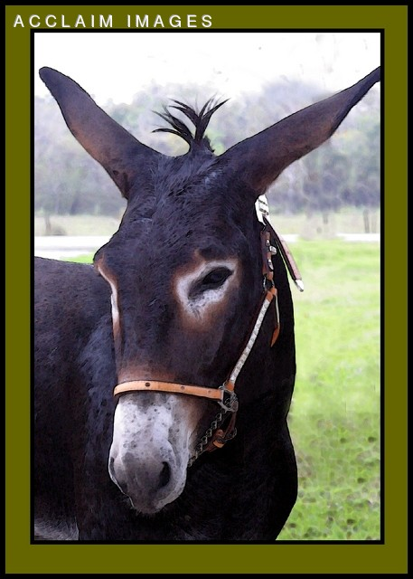
Cross-species Hybrids
Mules - horse (female) X donkey (male)
Hinny – horse (male) X donkey (female)
Some by man – e.g., mules, certain plant crops (Broccolini is a hybrid of broccoli and Chinese kale two closely related species of Brassica)
Natural horizontal gene transfer is surprisingly common.
Mixing by nature e.g., promiscuous oak, horizontal mitochondria gene transfer between algae & plants, protists, bacteria, viral origins of certain eukaryotic genes, microbial origin of mitochondria,

Slide 9
What Made Recombinant DNA Technology Possible?
ENZYMES that CUT & JOIN DNA
Restriction Endonucleases – cleave DNA in a predicable way, DNA ligase to join DNA pieces together
Early Landmarks
1970 Hamilton Smith – HindII from a gram negative bacterium, Hemophilus influenzae strain Rd
1971 Dan Nathans SV40 restriction map with 11 reproducible HindII DNA fragments (shared 1978 Nobel Prize with Hamilton Smith and Werner Abner)
1973 Herb Boyer & Stanley Cohen –first recombinant DNA molecules joining pieces of two plasmid DNAs
1974 Boyer, Cohen, Baltimore, Hogness, Nathans, Watson & others call for regulatory commission and limitations on research
1975 “Asilomar” meeting and moratorium on recombinant DNA experimentation – first self-imposed restrictions on government funded research imposed by the scientific community
1975-76 Recombinant DNA Molecule Program Advisory Committee (RAC) Guidelines for Recombinant DNA. Current NIH guidelines are posted on the class Canvas site and are required documentation in every laboratory where recombinant DNA techniques are used at the University of Kentucky.

Slide 10
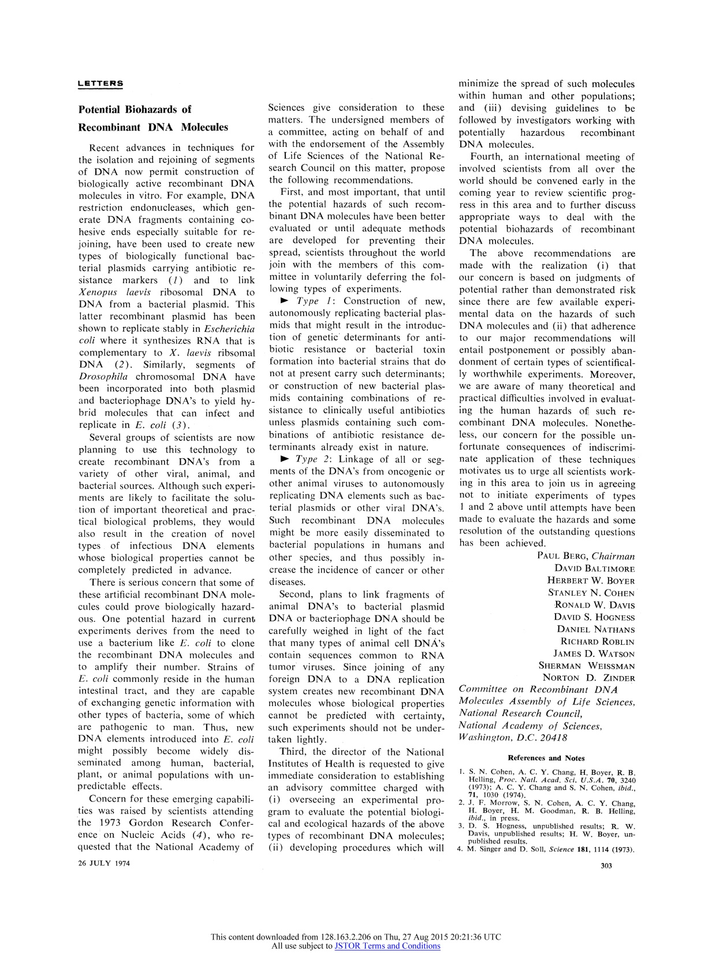
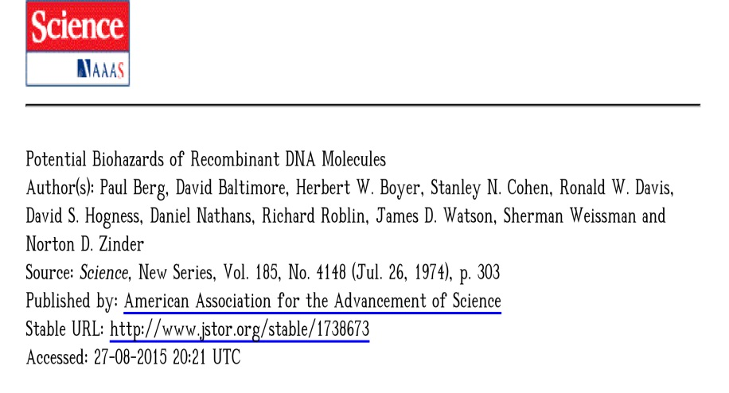
The original paper & Berg and Singer reflection after 20 years on class Canvas site under “Historical Papers”.

Slide 11
Table 1.1 Early timeline of genome sequencing – valuable input for genetic engineering
Genome sequenced Year Genome size Comment
Bacteriophage fX174 | 1977 | 5.38 kb | First genome sequenced
Plasmid pBR322 | 1979 | 4.3 kb | First plasmid sequenced
Bacteriophage lambda 1982 48.5 kb
Epstein–Barr virus | 1984 | 172 kb
Yeast chromosome III | 1992 | 315 kb | First chromosome sequenced
Haemophilus influenzae | 1995 | 1.8 Mb | First genome of cellular organism sequenced
Saccharomyces cerevisiae | 1996 | 12 Mb | First eukaryotic genome sequenced
Ceanorhabditis elegans | 1998 | 97 Mb | First genome of multicellular organism to be sequenced
Drosophila melanogaster | 2000 | 165 Mb
Arabidopsis thaliana | 2000 | 125 Mb | First plant genome to be sequenced
Homo sapiens | 2001 | 3000 Mb | First mammalian genome sequenced
Rice (Oryza sativa) | 2002 | 430 Mb | First crop plant to be sequenced
Pufferfish (Fugu rubripes) | 2002 | 400 Mb | Smallest known vertebrate genome
Mouse (Mus musculis) | 2002/3 | 2700 Mb | Widely used model organism
Chimpanzee (Pan
troglodytes) 2005 3000 Mb Closest to human genome

Slide 12
Progress in genome sequencing projects statistics 9/1/11 http://www.ncbi.nlm.nih.gov/genome/browse/
Organism | Complete | Draft assembly | In progress | total
Prokaryotes | 1088 | 802 | 623 | 2513
Archaea | 98 | 5 | 48 | 151
Bacteria | 990 | 797 | 575 | 2362
Eukaryotes | 34 | 312 | 300 | 646
Animals | 6 | 135 | 107 | 248
Mammals | 3 | 41 | 25 | 69
Birds |  | 3 | 13 | 16
Fishes |  | 15 | 17 | 32
Insects | 2 | 38 | 17 | 57
Flatworms |  | 2 | 3 | 5
Roundworms | 1 | 16 | 11 | 28
Amphibians |  | 1 |  | 1
Reptiles |  | 2 |  | 2
Other animals |  | 19 | 24 | 43
Plants | 5 | 31 | 81 | 117
Land plants | 3 | 27 | 74 | 104
Green Algae | 2 | 4 | 6 | 12
Fungi | 15 | 104 | 63 | 182
Ascomycetes | 11 | 80 | 42 | 133
Basidiomycetes | 2 | 16 | 11 | 29
Other fungi | 2 | 8 | 10 | 20
Protists | 8 | 39 | 46 | 93
Apicomplexans | 3 | 11 | 16 | 30
Kinetoplasts | 4 | 3 | 2 | 9
Other protists | 1 | 24 | 28 | 53
total: | 1122 | 1114 | 923 | 3159
Revised: Sep 01, 2011
8/24/17 Total 137,424 Eukaryotes [4697], Prokaryotes [105038], Viruses [7432], Plasmids [9900], Organelles [10357]

Slide 13
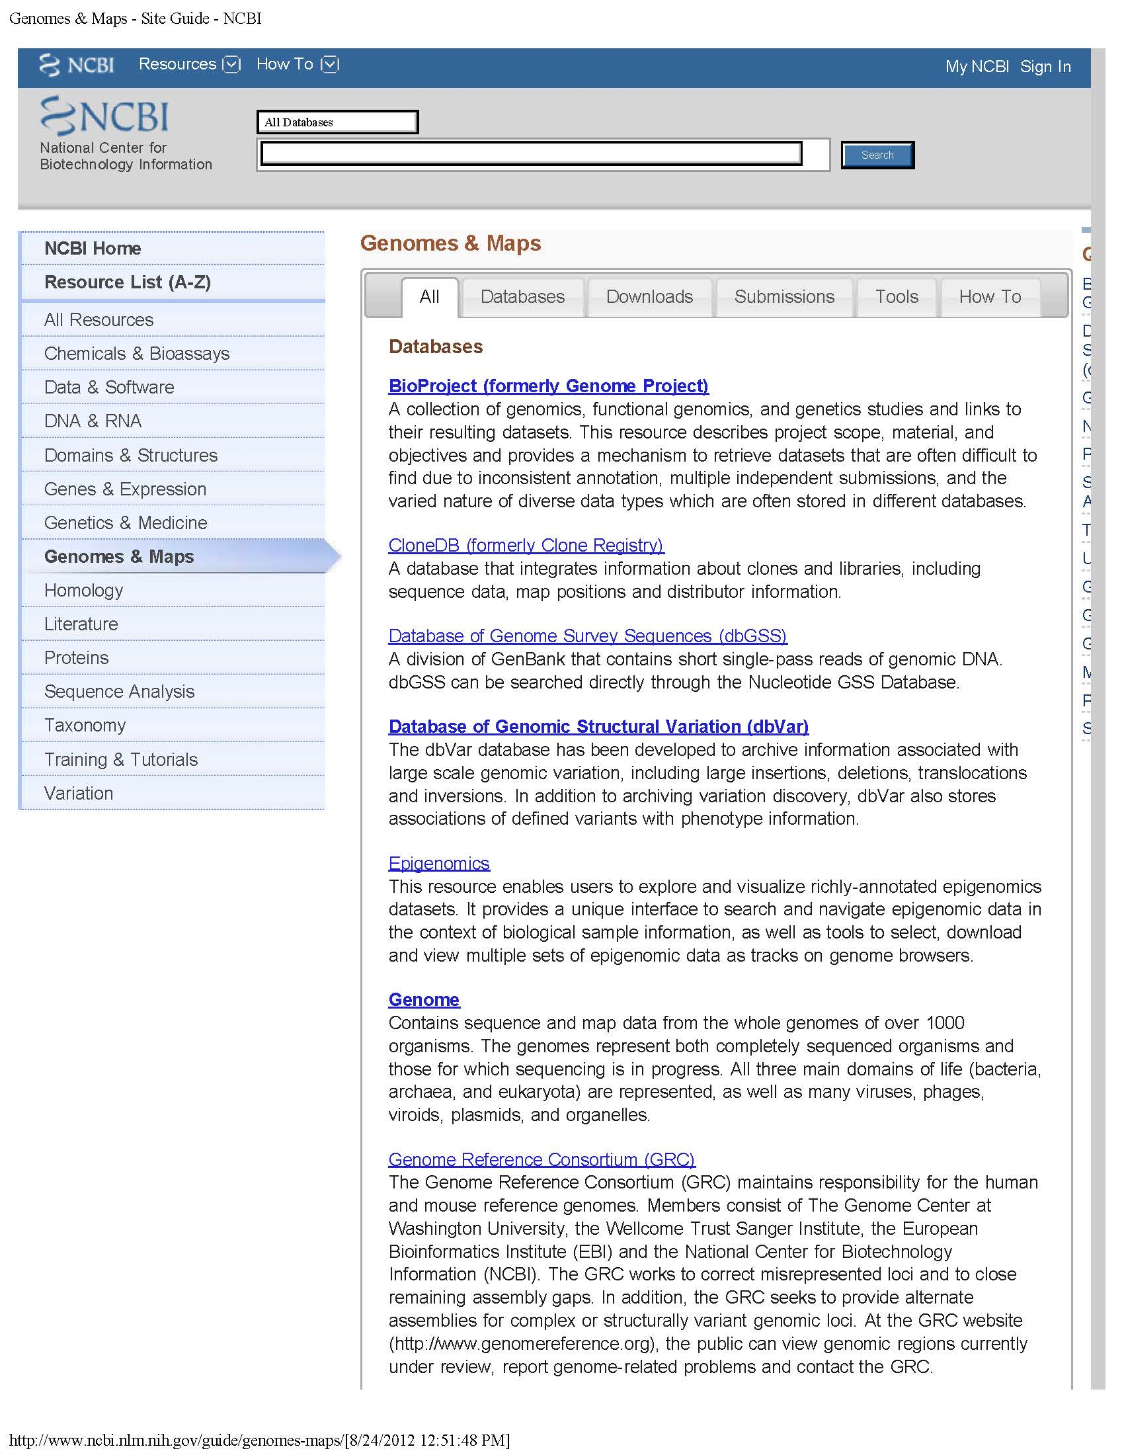
So many genomes are sequenced, where is this information?
http://www.ncbi.nlm.nih.gov/guide/genomes-maps/
National Center for Biotechnology Information (NCBI)
*Vast datasets (literature/ DNA/protein/structure)
*Online protein/nucleic acid analysis tools
*Disease and gene expression data sets
*Ongoing research projects
*Lots of other stuff

Slide 14
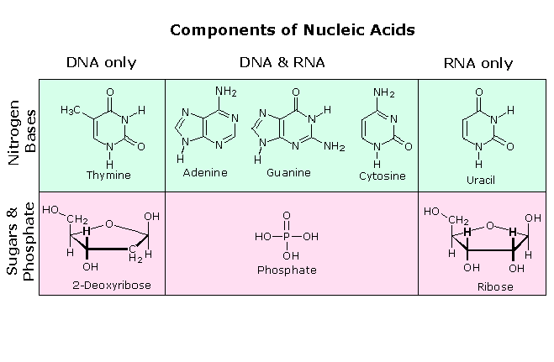
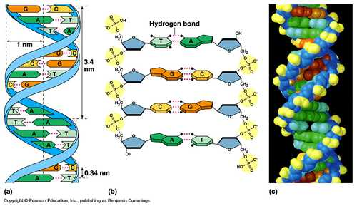
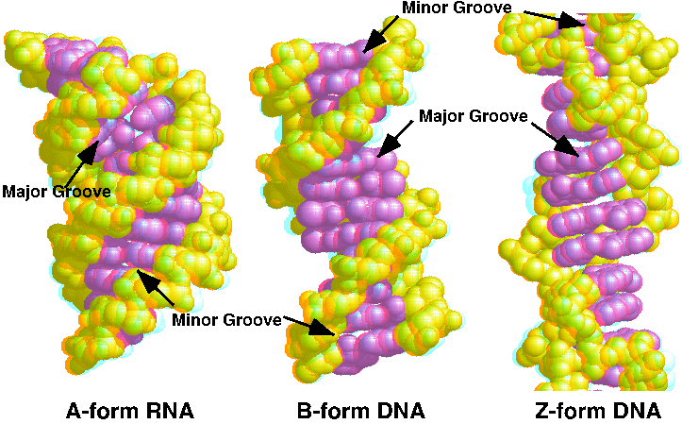
DNA double helices are most often B-form; RNA and RNA/DNA helices A-form; Z-form occurs in certain promoter regions with alternating Pu and Py nucleotides
A and B forms of DNA are right-handed helices, with the A form having a deeper and narrower major grove. Z-DNA is a left-handed helix (still W/C base pairing).

Slide 15
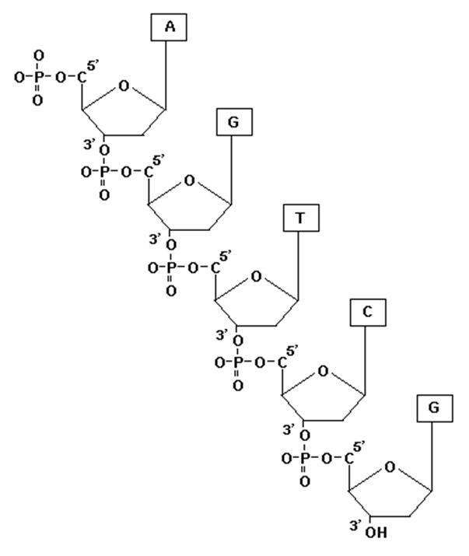
The reducing (-OH) end of the ribose/deoxyribose, the 3’ end of the sugar is the “business end”– New NTPs/dNTPs are added here during synthesis with the 3’OH acting as the nucleophile that attacks the alpha (i.e., base proximal) phosphate of the NTP resulting in phosphodiester bond formation and ppi (pyrophosphate) release.
Is this DNA or RNA?
The nitrogenous bases of DNA base pair between DNA strands and “stack” within a DNA strand to provide structural stability to the DNA helix,
but how do proteins recognize nucleic acids?

Slide 16
Amino acid side chains also hydrogen bond with nitrogenous bases through major and minor grove interactions (provides specificity & stability);
make hydrostatic interactions between backbone phosphates and positively charged amino acid side chains (provides stability);
other associations such as hydrophobic stacking between a nucleic acid base and planar ring amino acids such as tyrosine, phenylalanine or interactions with the peptide backbone can also provide stability & specificity.

Slide 17
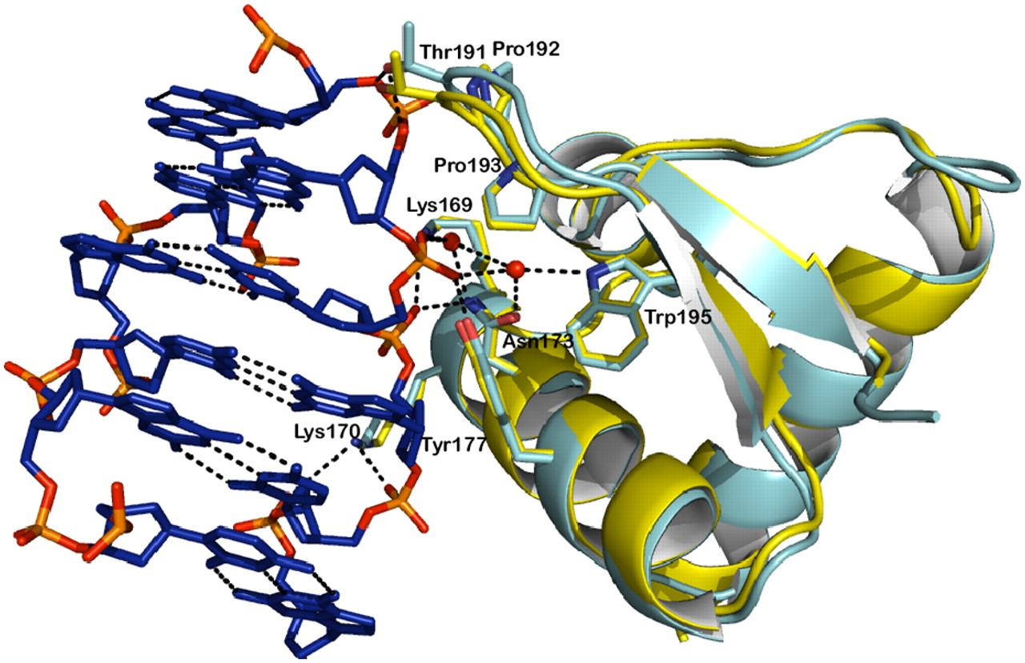
Conservation of the protein–DNA interactions in the Zα/Z-Z DNA complex.
Matteo de Rosa et al. PNAS 2010;107:9088-9092 (Z-DNA and a Z-DNA binding protein)
©2010 by National Academy of Sciences
Notes:
Conservation of the protein–DNA interactions in the Zα/Z-Z DNA complex. Superimposition of the Zα domain from the search model PDB ID 1QBJ (Cyan) and chain C of the Hepes-free structure of the ZZ junction (Yellow). Residues interacting with DNA are shown in stick representation, whereas dotted lines show hydrogen bonds. Side chains involved in interactions with DNA are drawn as sticks and labeled.

Slide 18
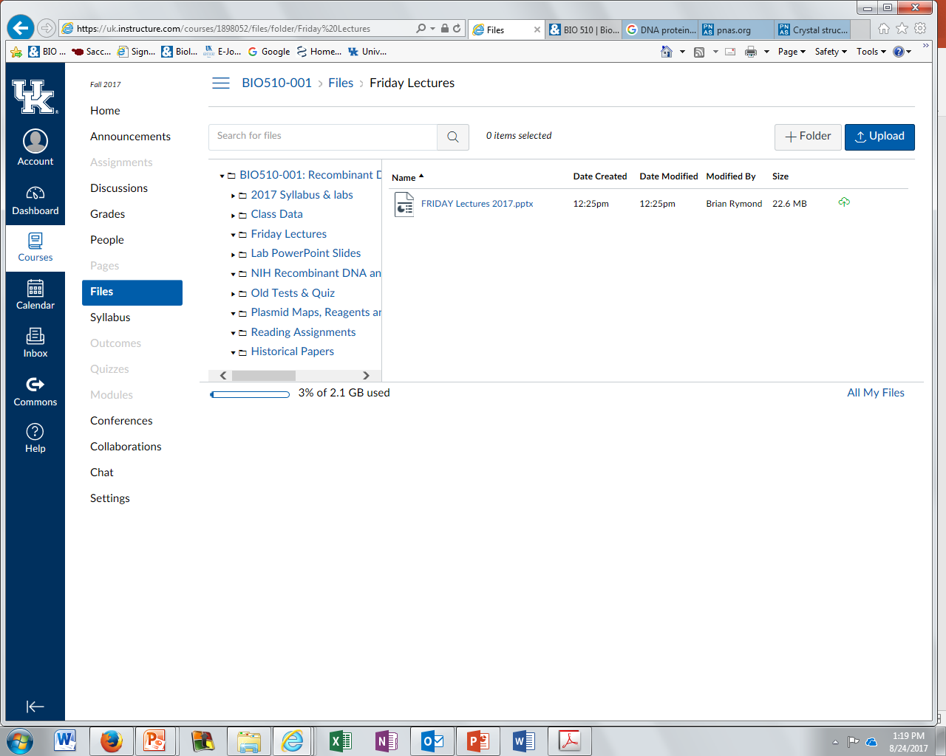
Remember – Friday lectures are on the Canvas website & updated weekly.

Slide 19
Last Lecture
Early history of recombinant DNA technology ~ 25 years from initial identification of restriction endonucleases to the point of rapid & efficient DNA sequencing.
Genetic exchange between organisms- natural (horizontal gene transfer) and directed (transgenic organisms)
Impact & ethics of recombinant DNA research
Knowledge of DNA sequence greatly expands experimental opportunities from design to execution.
Nucleic acid structure – A, B, Z double stranded helices; RNA & DNA; 5’ and 3’ (ribose) ends of DNA

Slide 20
This Weeks Lab Work
Silica based (Qiagen) recovery of yeast (insert) DNA after size fractionation on agarose gel – worked well
pTZ18u (pTZ19u) vector DNA cleavage worked well for most
Next Week – Wednesday
Sept 6: LAB 3.
Joining DNA ends with T4 DNA ligase; isolation of total RNA from yeast; impact of increased salt concentration on DNA migration
Reading assignments: NEB 103 (Gibson Assembly), 113 (T4 PNK); 132 (EcoRI methyltransferase); 109 (T4 DNA ligase), 288- 289 (charts), 313-14, 341-346, 356-358 (charts related to enzyme use);
PGMG chapters 4 (except the bacteriophage lambda stuff), Chapter 5 pages 75-81; 82-85 (specialized vectors for RNA probes) 94-95 (Gateway)
homework due; online safety training documentation due

Slide 21
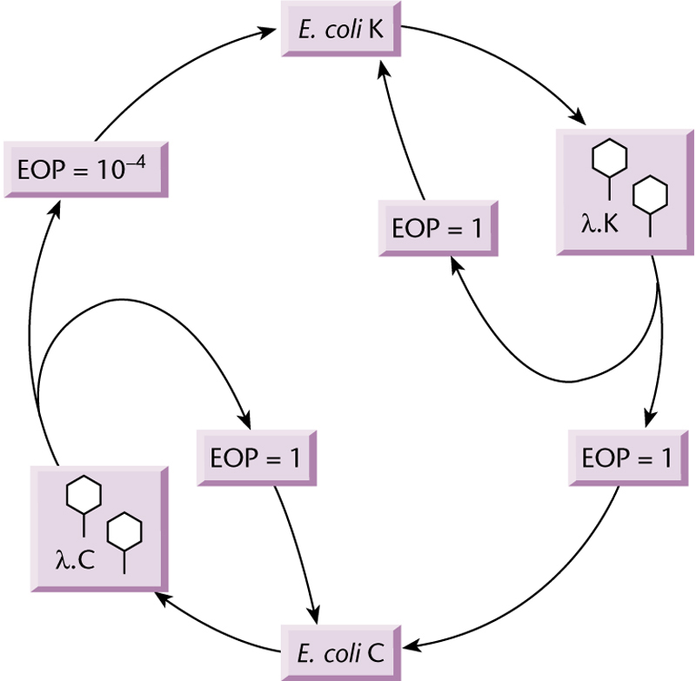
R/M (restriction/modification) systems a form of microbial immunity.

Slide 22
We’ve had a pretty smooth start to the lab experiments
Lab work flow will improve………………..by familiarity with protocols, coordination between lab members, TA/instructor trouble shooting – in essence, experience. Put in the effort and by the end of the course, every student in the class will be able to design, execute and evaluate molecular genetic experiments.
We do not grade based on quality of results. But the labs build on one another, what happens if something goes wrong?
Borrow from your lab partner or another group
Backup reagents and the products of completed experiments are available from the TAs if you cannot find what you need
Learn to evaluate a failed experiment – this has value; trouble shooting skills are critical in science (& life). While no one recommends sabotaging an experiment as a learning experience, valuable discoveries can be made from an experiment “gone wrong”.

Slide 23
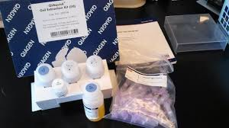
Gel extraction protocol: Qiagen kit was used to concentrate and also remove salts, agarose, ethidium bromide, and other impurities from the gel fractionated DNA sample
Binding capacity | 10 µg
Elution volume | 30–50 µl
Format | Tube
Fragment size | 70 bp – 10 kb
Processing | Manual
Recovery: oligonucleotides dsDNA | Recovery: dsDNA fragments
Removal <10mers 17–40mers dye terminator proteins | Removal <10mers
Sample type: applications | DNA: PCR reactions
Technology | Silica technology
Variations on this kit available, for instance, for plasmid isolation or PCR cleanup – essentially all use the same technology but may vary in resin quantity, packaging & minor details in the solutions provided (which are generally not disclosed in the manual).
The kits are expensive – can the columns be reused? The reagents prepared in bulk?

Slide 24
Molecular Biology is driven by enzymes that copy, cleave, join, or modify nucleic acids. You need to know what is in the toolbox.
Enzymes that cut DNA and/or RNA: Nucleases
Types: Ribonucleases vs Deoxyribonucleases - substrate specificity RNA or DNA, respectively.
Endonucleases vs Exonucleases - cleavage site within (internal regions of the) DNA chain or at the ends of the DNA, respectively.
Single strand or double strand (or both): structure specificity

Slide 25
Examples
Double stranded endodeoxyribonuclease: standard restriction enzymes, e.g., EcoRI, HindIII (used on Monday)
Restriction endonucleases are microbial site-specific DNA cutting enzymes typically associated with a methylase activity.
The role of the associated methylase is to chemically modify (methylate) the host cell genomic DNA to protect it from cleavage by the endonuclease
But why to bacteria have restriction/modification systems?

Slide 26
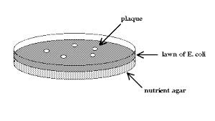
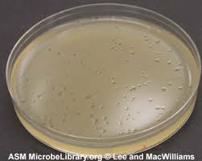
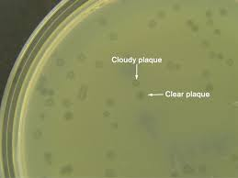
Protection against viral infection
Plaques are areas of active viral infection & look like “holes” on a thick lawn of bacteria. Assume each plaque starts from a single infected bacterium.
Efficiency of plating (EOP) is a measure of viral infectivity – where “1” is 100% infection (every infected cell produces virus).
An EOP measure of 10⁻⁴ indicates 0.01% infection (1 in 10,000 infected cells produce virus).

Slide 27
Restriction /Modification Enzymes as a microbial immune system
λ Plating Efficiency
E. coli strain used to prepare virus stock
E. coli strain K B C
infected with virus
K 1 10-4 10-4
B 10-4 1 10-4
C 1 1 1
Conclude: B/K E. coli strains differ in their “immune” response because B and K have distinct and different restriction/modification systems
C is R-M- since phage propagated in strain C are restricted (few plaques) when presented to either E. coli strain K or B (“C” propagated phage is not modified and vulnerable to destruction) and
Phage from K or B bacteria are not restricted (many plaques) on strain C (since “C” E. coli have no restriction system to destroy unmodified DNA).

Slide 28
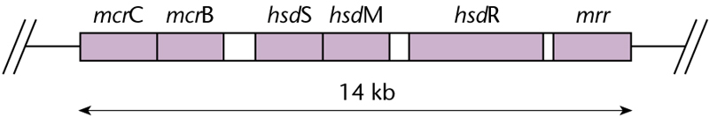
Natural E. coli restriction systems (differ from one another in DNA sequence specificity & in sensitivity to DNA methylation)
EcoK system includes the Hsd restriction (hsdR) enzyme gene cuts DNA that is NOT protected by methylation. EcoK site recognition is (5' AA*CNNNNNNGTGC3‘ on average found 1/16,000 bp but can be more common, e.g., the 4361 bp pBR322 has 2 sites). EcoK methylase (hsdM) modifies adenosine in AA(N6)CGTGC. HsdS is a DNA sequence specificity factor needed for both methylation & cleavage. Unmodified DNA introduced into a strain with the EcoK restriction enzyme will be destroyed. HsdR deficient strains are rest-, mod+ . HsdS deficient or HsdM deficient strains are rest-, mod-
Clustered gene sets in the E. coli chromosome. Such structural & functional linkage is common in bacteria but much less so in higher eukaryotes (with certain striking exceptions such as rDNA repeats, histone genes, U-small nuclear RNA genes)

Slide 29
For cloning of foreign DNA sequences in E. coli, the most important is the type I system encoded by the hsdR, hsdM and hsdS genes. The products of all three genes form a multimeric enzyme capable of cleaving or methylating a particular target sequence (5´-AAC[N₆]GTGC-3´ in E. coli K12 strains).
If the target sequence is hemi-methylated (only one strand is methylated as occurs during DNA replication of the host chromosome), then the enzyme acts as a methylase thus protecting the sequence from cleavage.
If the sequence is not methylated on any strand, then the enzyme acts as a restriction endonuclease and cuts the target sequence.
Typically DNA from another organism will not be methylated at the EcoK target sequence and will be degraded when introduced into a E. coli that is wildtype for all three hsd genes.
Mutations in either the hsdM or hsdR genes result in a restriction-modification minus phenotype (r–, m–). DNA propagated in this genetic background is not subject to endonuclease cleavage but similarly is not methylated. Consequently, plasmid DNA isolated from such a strain cannot be introduced into a strain that is wildtype for hsdR, hsdM and hsdS (r⁺, m⁺) as it will be degraded. Such DNA has to be passed through a restriction minus modification plus strain such as JM109 to protect it from cleavage. Thus, before transforming a plasmid into a different strain of E. coli, it is important to consider the hsdR, hsdM and hsdS genotype of the strain that the plasmid was grown in as well as the genotype of the strain into which you plan to transform it.
http://www.promega.com/resources/articles/pubhub/enotes/what-are-the-effects-of-the-bacterial-dna-restriction-modification-systems-on-cloning/

Slide 30
Natural E. coli restriction systems
What are the mcrC/B and mrr genes?
Another E. coli restriction enzyme systems that also protect the bacteria but act in a distinct way………………….

Slide 31
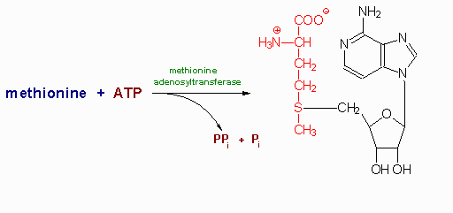
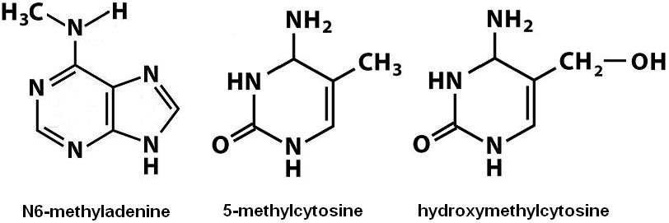
Natural E. coli restriction systems
McrA and McrBC are two restriction systems with similar specificity; cut only when DNA IS methylated at C*pG within sequence specific regions (NEBiolabs). Mrr is a similar enzyme that cuts at methyladenosine (no obvious consensus), and doesn't cut DNA at dam, EcoK or EcoR1 sites.
Most complex eukaryotes (including plants) and some bacteria but not yeast or Drosophila have 5 methylcytosine and so it is important to use Mcr ‑ strains. 6-methyl adenosine found in many lower eukaryotes (e.g., insects) and plants and so mrr‑ strain should be used there – otherwise, most of the foreign DNA will be cleaved and destroyed in E. coli. S-adenosylmethionine (SAM) is the methyl donor.
Note: Once in E. coli, the host methylation pattern is lost – so any methylated DNA that survives replication will be fine thereafter.
http://rebase.neb.com/rebase/rebms.html
N-4 methyl C also in bacteria HN-CH3
DNA + Modification enzyme
SAM

Slide 32
Dam, Dcm: Two methylases in E. coli that can impair certain restriction enzyme function but are NOT naturally associated with a bacterial nuclease – have methyltransferase enzymatic activity only).
Dam transfer methyl group from S‑adenosylmethionine to N6‑adenosine in the sequence GA*TC (these sequences are not cut my Mrr). Dcm methylase modified C5 in the sequences CCAGG and CCTGG.
These methylation sites can, when present in a restriction endonuclease site generally inhibit (partially or completely), the cutting of a restriction endonuclease.
For a very limited number of restriction enzymes the methylation is stimulatory – but these are rare exceptions, most often the methylation inhibits DNA cleavage

Slide 33
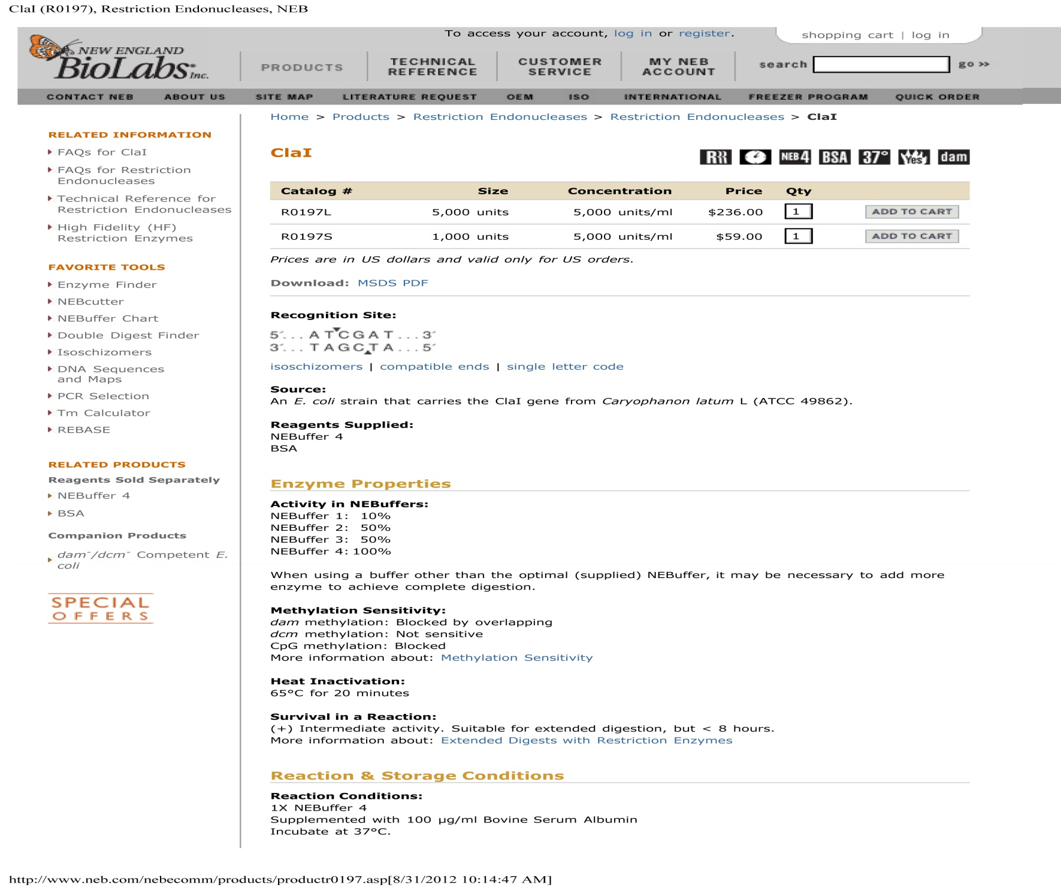
10X Buffer 4 Components
500mM Potassium Acetate
200mM Tris-acetate
100mM Magnesium Acetate
10mM DTT
pH 7.9@25°C

Slide 34
Many lab bacterial strains are dcm+/dam+, always check to see if your enzyme is Dam/Dcm sensitive before use. http://rebase.neb.com/rebase/rebms.html
Relevant to plasmid DNA transformation of E. coli. Dam/Dcm modified DNA introduced into a dam or dcm deficient strain replicates once and then arrests replication in a hemi-modified state.
THE REASON: In a Dam+ strain, fully methylated DNA is replicated to hemi-methylated state and this signals the cell to stop replicating. Dam+ methylation would then normally occur on the unmethylated strand in the newly divided cell to produce the full methylated dsDNA substrate ready for replication --- but this cannot happen in a Dam- mutant where the methylase is missing (so the DNA stays in this limbo state where it cannot be replicated)

Slide 35
Nucleic Acid joining enzymes: Naturally occurring enzymes for cellular or viral replication or repair.
DNA ligase: Covalently joins a free 5' phosphate and free 3' hydroxyl to form a complete nucleic acid chain. This enzyme will seal nicks (but not gaps) in double stranded DNA as well as join the ends of two separate molecules.
DNA ligase requires a double stranded substrate (DNA, RNA or RNA/DNA hybrid). Examples, T4 or E. coli DNA ligase; require nucleotide co-factors (ATP & NAD+, respectively). Important cloning enzyme.

Slide 36
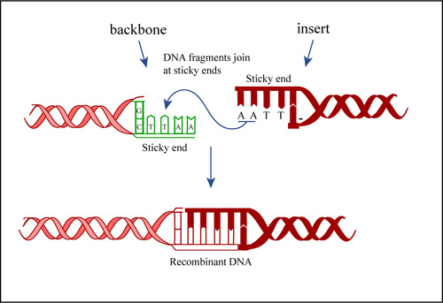
EcoRI “sticky” ends; 5’ extension
A G C T—(HindIII)
http://ocw.mit.edu/courses/biological-engineering/20-109-laboratory-fundamentals-in-biological-engineering-fall-2007/labs/mod1_3_dnaligatn.jpg
Next week we will ligate (join) together the pTZ18u/19u plasmid backbone with the yeast DNA insert using T4 DNA ligase to seal the compatible EcoRI/EcoRI and HindIII/HindIII ends of our two DNA species.

Slide 37
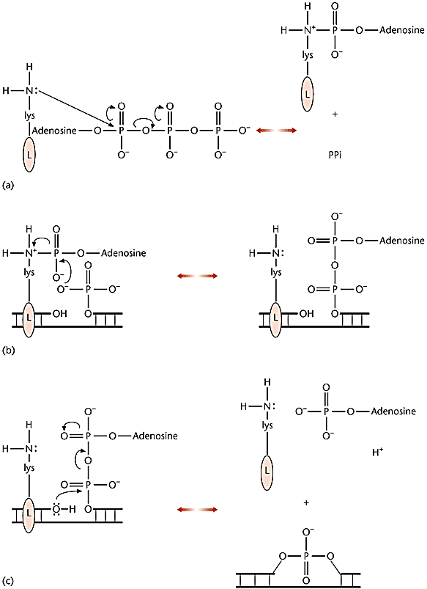
T4 bacteriophage (viral) & eukaryotic DNA ligase reaction
Ligase protein is first covalently modified – charged with AMP (pyrophosphate released)
Ligase binds DNA and passes AMP to 5’ phosphate of DNA – making high energy bond
Nucleophilic attack by the 3’ hydroxyl of DNA on the diphosphate seals the dsDNA with a phosphodiester bond, releasing AMP and ligase
Ligase joins together two DNA molecules –
but how does it work?

Slide 38
http://ocw.mit.edu/courses/biological-engineering/20-109-laboratory-fundamentals-in-biological-engineering-fall-2007/labs/mod1_3_dnaligatn.jpg
End result is covalently joined (ligated) DNA ends which reform the continuous phosphodiester backbone of DNA.

Slide 39
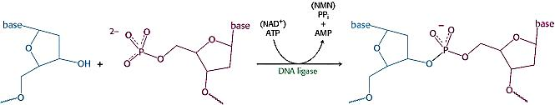
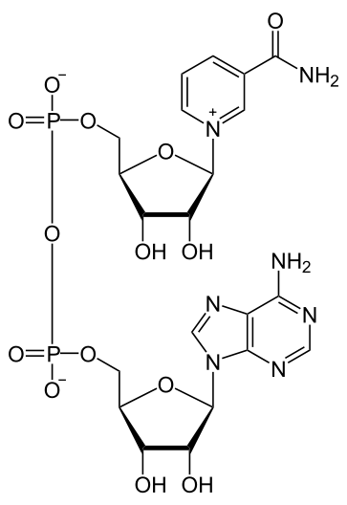
In bacteria, NAD⁺ is cleaved to produce nicotinamide mononucleotide (NMN) + ppi during ligation
Free DNA 5’ phosphate & 3’ hydroxyl joined by ligase
Here NAD+ charges the ligase protein with AMP – the rest of the chemistry is the same as with T4 DNA ligase
nicotinamide adenine dinucleotide, oxidized (NAD+) - still adenylate transfer to ligase, simply different starting compound
http://www.ncbi.nlm.nih.gov/books/NBK22587/figure/A3801/?report=objectonly

Slide 40
Nucleic Acid joining enzymes: Naturally occurring enzymes for cellular or viral replication or repair.
RNA ligase: Covalently joins a free 5' phosphate and free 3' hydroxyl to form a complete nucleic acid chain. RNA ligase requires a single stranded substrate (DNA or RNA) and a nucleotide cofactor. Example, T4 RNA ligase (+ ATP).
RNA ligase is useful to make 3’ end-labeled RNA (e.g., with a radioactive, biotin substituted or florescent nucleotide) to use as a probe, for structure analysis or RNA enzymology.

Slide 41
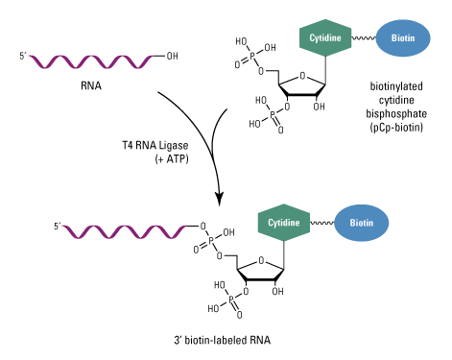
T4 RNA ligase – reaction mechanism similar to DNA ligase in going through a covalent RNA ligase-nucleotide intermediate prior to transfer of the label to the 3’ end of the RNA chain.
Here the 3’ phosphate on the label is present to limit addition to one biotin nucleotide per RNA.
(³²⁻P) pCp is commonly used to radiolabel 3’ ends with RNA ligase.

Slide 42
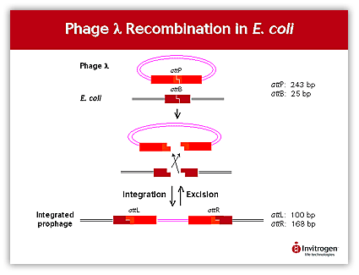
Ligase-free DNA cloning
attP
https://www.embl.de/pepcore/pepcore_services/cloning/cloning_methods/recombination/gateway/
Image of circular lambda phage integrating into E. coli chromosome (only partial chromosome shown)
attB
attL
attR
The GATEWAY Cloning Technology is based on the site-specific recombination system used by phage λ to integrate its DNA in the E. coli chromosome. Both organisms have specific recombination sites called attP in phage λ site and attB in E. coli.
NOTE: attL and attR are hybrid sites of mixed (attP and attB sequence)

Slide 43
Last Lecture
Host restriction/modification systems as a defense mechanism
hsdS, HsdM, hdsR (EcoK)– methylation in bacteria protects specific target sequences from cleavage by the endonuclease (specificity factor [S], methylase [M] and restriction endonuclease[R])
Mrr, MrcA, MrcB/C – (endonuclease only) normal DNA methylation by another organism (e.g., human) stimulates DNA cleavage by these bacterial endonuclease enzymes (three different methylation patterns recognized). Note, the eukaryotic methylation of recognition sequences can also inhibit certain restriction enzymes.
Dam and Dcm methylation (methylase only)
Not associated with an endonuclease but acts as a mark for replication. Plasmid DNA from Dam+ and/or Dcm+ E. coli transformed into Dam-, Dcm- E. coli will replicate once and stop.
Many common restriction enzymes used in the lab are inhibited by Dam or Dcm methylation (some are insensitive and very few are enhanced by methylation).

Slide 44
E. coli Enzyme | Specificity | Role in Cell | Recombinant DNA
EcoK; HsdR/M/S (endonuclease, methylase and specificity factors); EcoB system similar | Site specific 5'AA*CNNNNNNGTGC 3’; methylation by bacteria blocks DNA cleavage | Protects against foreign DNA (viruses lack this methylation, hence destroyed by the cell) | Recombinant DNA will not be methylated at this sequence & will be cut (destroyed) by this enzyme in E. coli; poor transformation
McrA, McrB/C (endonuclease activity only) | C*pG; methylation stimulates DNA cleavage | Protects against foreign DNA | C*pG methylation very common in higher eukaryotes; foreign DNA will be cut (destroyed) by this enzyme in E. coli; poor transformation;
Mrr (endonuclease activity only) | Cuts methyladenosine | Protects against foreign DNA | methylation very common in other microbes; foreign DNA will be cut (destroyed) by this enzyme in E. coli; poor transformation
Dam; Dcm (methylase activity only) | GA*TC (Dam); CC*AGG and CC*TGG (Dcm) | Used as a bookkeeping tool for replication | Unmethylated DNA transformed into a Dam/Dcm + cell will replicate once and stop; poor transformation; methylation can block restriction enzymes

Slide 45
The GATEWAY Cloning Technology
The integration process (lysogeny) is catalyzed by 2 enzymes: the phage λ encoded protein Int (Integrase) and the E. coli protein IHF (Integration Host Factor).
Upon integration, the recombination between attB (25 nt) and attP (243 nt) sites generate attL (100 nt) and attR (168 nt) sites that flank the integrated phage λ DNA.
The process is reversible and the excision is again catalyzed Int and IHF in combination with the phage λ protein Xis to reform the attP site in phage λ and the attB site in the E. coli chromosome.

Slide 46
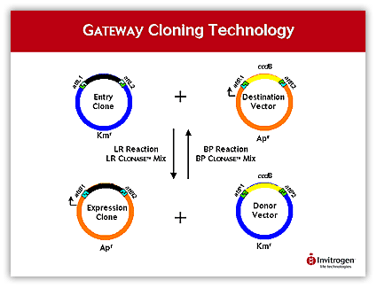
You can use this technique to swap DNA inserts plasmids (here move black insert into orange vector)
Entry clone has your insert DNA flanked by attL1 and attL2; destination vector with attR1 and attR2.
attL1 is joined with attR1 & attL2 with attR2 (forming AttB1 and B2 in the expression clone)
attL1, L2
attR1, R2
attB1, B2
attP1, P2
The GATEWAY reactions are in vitro versions of the integration and excision reactions.
To make the reactions directional two slightly different and specific sites were developed, attL1 and attL2 for each recombination site. In the BP Reaction attB1 only reacts with attP1 resulting in attL1 and attR1, and attB2 only with attP2 giving attL2 and attR2. The reverse reaction (LR Reaction) shows the same specificity.
LR clonase = Int + IHF + Xis (because of attL and attR); BP clonase = Int + IHF
Note: The entry clone with your DNA of interest can be made by traditional cloning or with a PCR product flanked by AttL1,2 sites plus a commercial destination vectors flanked by attR1/2.

Slide 47
Restriction Endonucleases: The DNA cutting component of bacterial species specific restriction/modification systems. These nucleases are capable of producing double-stranded DNA cuts. The DNA cleavage activity is altered (stimulated or blocked) by the methylation of the restriction enzyme recognition site by the associated methylation activity.
The restriction/modification system of bacteria acts somewhat like the immune system of higher organisms in that it protects the host from invasion by pathogens such as viruses.
Three or four types or classes of restriction endonucleases are known. These include………………………………….

Slide 48
Type I (Enzyme classes –see http://rebase.neb.com/rebase/rebase.enz.html )
The key characteristics of the Type I R-M systems are that these enzymes are multisubunit proteins that function as a single protein complex and usually contain two R subunits, two M subunits, and one S subunit. After locating their recognition site they serve as molecular motors to translocate DNA until a collision occurs that triggers cleavage. The resulting fragments thus tend to be fairly random. HsdM/R/S; Require ATP.
Type II - these are the most common enzymes used for recombinant DNA work
The Type II restriction systems typically contain individual restriction enzymes and modification enzymes encoded by separate genes. The Type II restriction enzymes typically recognize specific DNA sequences and cleave at constant positions at or close to that sequence to produce 5-phosphates and 3-hydroxyls. Usually they require Mg2+ ions as a cofactor, although some have more exotic requirements. Do not require ATP. The methyltransferases usually recognize the same sequence although some are more promiscuous. Three types of DNA methyltransferases have been found as part of Type II R-M systems forming either C5-methylcytosine, N4-methylcytosine or N6-methyladenine.
Type III
These systems are composed of two genes (mod and res) encoding protein subunits that function either in DNA recognition and modification (Mod) or restriction (Res). Both subunits are required for restriction, which also has an absolute requirement for ATP hydrolysis. For DNA cleavage, the enzyme must interact with two copies of a non-palindromic recognition sequence and the sites must be in an inverse orientation in the substrate DNA molecule. Cleavage is preceded by ATP-dependent DNA translocation as with the Type I Reases (but do not hydrolyze the ATP). The enzymes cleave at a specific distance away from one of the two copies of their recognition sequence. The Mod subunit can function independently of the Res subunit to methylate DNA: in all known cases the methylated base formed is N6-methyladenine and full modification is actually hemi-methylation.
Type IV
These systems are composed of one or two genes encoding proteins that cleave only modified DNA, including methylated, hydroxymethylated and glucosyl-hydroxymethylated bases. Their recognition sequences have usually not been well defined except for McrBC, which recognizes two dinucleotides of the general form RmC (a purine followed by a methylated cytosine either m4C or m5C) and which are separated by anywhere from 40-3000 bases. Cleavage takes place approximately 30 bp away from one of the sites. Do not require ATP.

Slide 49
Type II. Most often two different protein subunits which act independently, one is the endonuclease and the other is the methyl transferase. The endonuclease often acts as a dimer binding opposite faces of the DNA. The methylase usually functions as a monomer. Recognition pattern often a short (6-12 bp).
Cleavage occurs within or nearby the recognition sequence. Endonuclease cleavage requires Mg⁺⁺ but not ATP. Most type II enzymes do not require S-adenosylmethionine (SAM) for activity. However, for a small number of type II endonucleases the methylase resides in the same polypeptide chain and the endonuclease (i.e., type IIG; example AcuI) & then SAM is stimulatory for the endonuclease.
Type II endonucleases always leave 5’ phosphate after cutting, in contrast acid hydrolysis of DNA chain leaves 3’ phosphates.
See other type II subtypes: http://rebase.neb.com/cgi-bin/sublist

Slide 50
Type IIP - Recognize palindrome sequence and cut within. Example, EcoRI
5 G/AATTC 3’
3’CTTAA/G 5’
What are the components of a typical restriction endonuclease reaction mix? https://www.neb.com/products/r0101-ecori#pd-description

Slide 51



1. 5’ extension: EcoRI
2. 3’ extension: KpnI
3. Blunt: SmaI
DNA “ends” left after cleavage: “blunt or flush” with no un-base paired DNA or “sticky” with either 5’ or 3’ single stranded DNA extensions.
Blunt ends can always be joined but sticky ends require complementarity (so, the sequences must base pair).

Slide 52
DNA cut with an enzymes that leaves 5’ sticky ends can only be joined with DNA cut with an enzyme that leaves compatible 5’ sticky ends, never with an enzyme that leaves 3’ sticky ends no mater what the sequence is.
Enzymes that leave 3’ sticky ends can only be joined with DNA cut with an enzyme that also leaves compatible 3’ sticky ends, never with an enzyme that leaves 5’ sticky ends no mater what the sequence is.
Can you show this to be true?
5’..A/AATTT ..3’
3’..TTTAA/A..5’
5’..GAATT/C ..3’
3’..C/TTAAC..5’
A B C

Slide 53
Variations on a common theme – some other types of recognition sequences
Some type II can recognize and cut within interrupted palindromes in which a particular segment can be any sequence. Example, BstXI
5’ CCANNNNN/NTGG 3’
3’GGTN/NNNNNACC 5’
Recognize an asymmetric sequence and cut within that sequence. Example, BbvCI 5’ CC/TCAGC 3’
3’ GGAGT/CG 5’
Recognize 4-6 base sequence, usually asymmetric, and cleave at a precise site 1-20 nucleotides away (type IIA). Example, EarI 5’ GGATG(N)12’
3’ CCTAC(N)10’

Slide 54
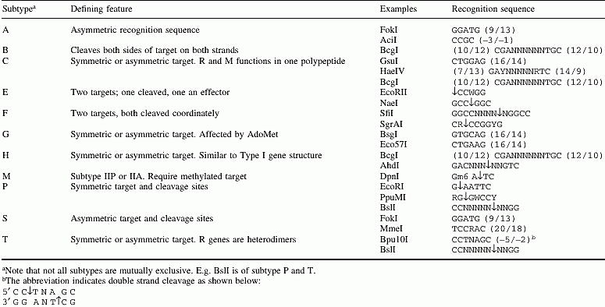


Type II subtypes as defined by NEB

Slide 55

Nicking enzymes. Any of the above engineered to cleave only one strand. Might be an enzyme that cannot form dimers or one in which only one subunit of the dimer is enzymatically active. Example, N. BbvC IA
5’ GCT/GAGG3’
3’ CGACTCC5’ (cleavage only on top strand, between T and G)
A few eukaryotic, site specific, double strand DNA endonucleases have been identified (e.g., yeast omega; HO, Flp) though these enzymes do not possess modification subunits and function in cellular roles other than host DNA protection. Recognition sequences are often very rare (e.g., DNA rearrangements, homing endonucleases such as Sce I, see NEB catalog). 5’TAGGGATAA/CAGGGTAAT 3’ (makes ds cut (1/4)¹⁸ bp random DNA)
–see http://rebase.neb.com/rebase/rebase.enz.html
enzyme recognition seq. , genome information, cut patterns, etc
• Specificity Subunits • Control Proteins • Enzyme sub types... | • Newest Enzymes • Putatives • Type IIS | • Type I • Type IIG • Type IIB | • Type III • Type IV | • Homing • Weirdos | • Nicking Enzymes • Methyl-Directed
Man-made nucleases: Zinc Finger, TALEN and CRISPR/Cas – designed to cut at investigator-defined sequences.

Slide 56
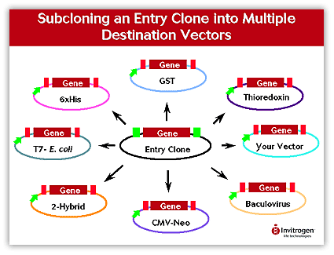
Once your entry clone is made with your gene of interest (by standard ligation or the BP reaction) you can efficiently shuttle your gene into in any of many different commercially available destination vectors by a simple, fast in vitro recombination.
Just add the two plasmids and the clonase mix (LR clonase = Int + IHF + Xis) in a microfuge tube & the “insert” DNA is transferred to the new vector. No need for the use of restriction enzymes or ligase.

Slide 57
The expected frequency of DNA cleavage by restriction enzymes depends on the complexity of the recognition sequence.
For instance, for the common 6-base cutter, EcoRI, the frequency of its recognition sequence (GAATTC) is ¼ x ¼ x ¼ x ¼ x ¼ x ¼ = once per 4,096 base pairs.
For the more relaxed 6 base cutter, BsrFI (PuCCGGPy), this is ½ x ¼ x ¼ x ¼ x ¼ x ½ = once every 1024 base pairs.
For the I-SceI homing endonuclease (18 bp recognition site), 5’TAGGGATAA/CAGGGTAAT 3’, is found, on average, once per 6.8 x 10¹⁰ base pairs (once per 68 billion base pairs –human genome has only 3 billion base pairs). I-SceI is encoded by an intron sequence within the mitochondrial 21S rRNA gene of baker’s yeast (Saccharomyces cerevisiae)
But is cleavage site frequency of within natural DNA accurately predicted by random nucleotide composition?

Slide 58
The answer is “many times” but the actually pattern also depends upon the nucleotide composition of the genome and the particular restriction site.
Some genomes are average more A/T rich (many eubacteria, intronic DNA in eukaryotes) while others have a greater G/C content. In addition, certain nucleotide combinations are more rare than others, e.g., 5’CG3’ is found at only 20% of its predicted frequency in human nuclear DNA.
A “6-base cutter” such as ApaI (5’GGGCCC3’) is expected to generate fragments that are, on average, 4,096 base pairs in length.
However, DNA fragments that average 2,000 base pairs are recovered from the human genome (that is, the enzyme cuts more frequently than predicted by the assumption of random based composition) and
fragments of average length of 25,000 base pairs in the A/T rich Arabidopsis genome (cuts less frequently than predicted).

Slide 59
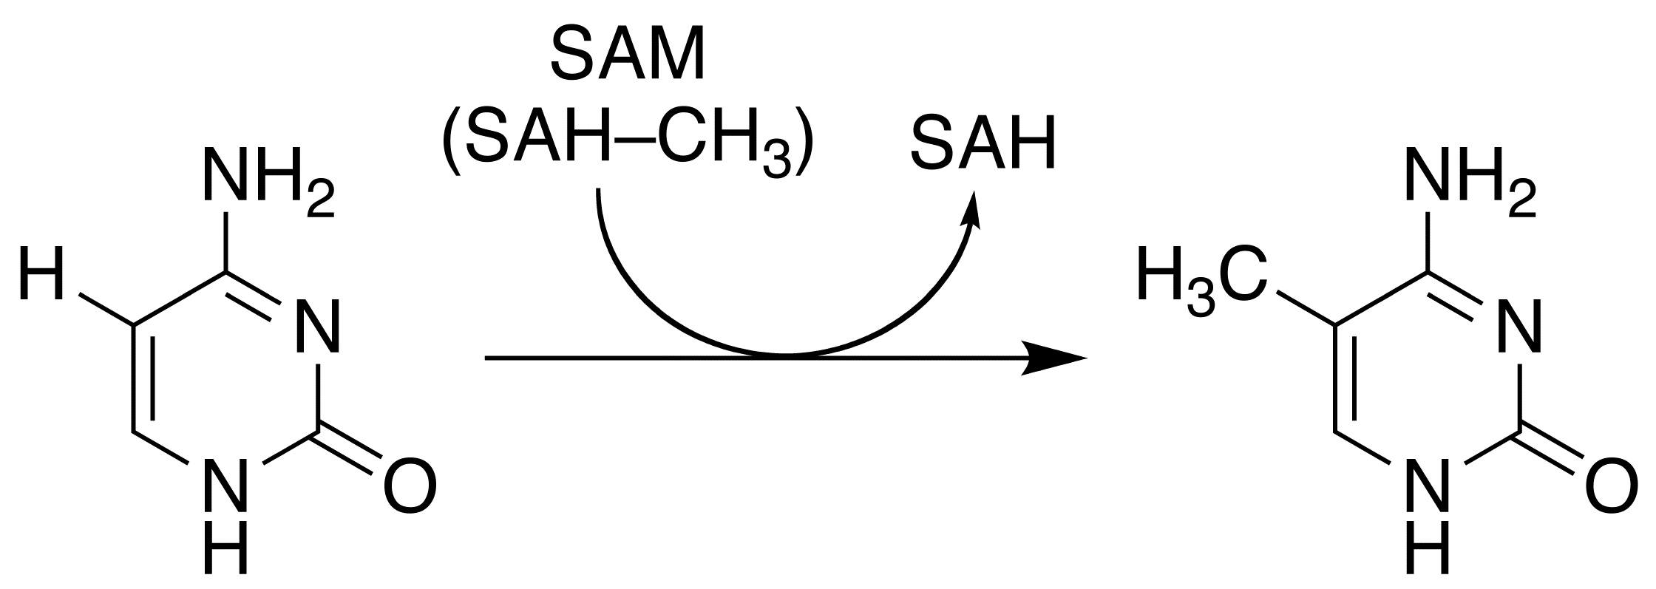
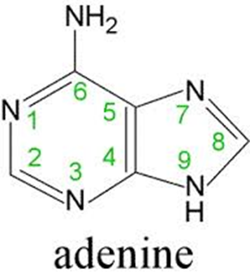

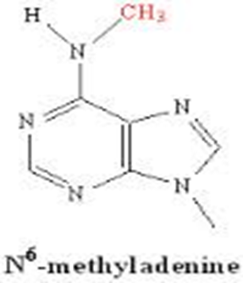
DNA Methylases – modify/protect DNA (EcoRI methylase)- blocks cleavage by the associated restriction endonuclease nuclease.
Most common nucleic acid methylation sites: C5-methylcytosine, N4-methylcytosine or N6-methyladenine
Eco RI Methylation Site
Source:
An E. coli. strain that carries the cloned EcoRI modification gene from Escherichia coli RY13 (R. N. Yoshimori)
How might you use such a DNA methylase activity to your advantage?

Slide 60
One example is to block restriction endonuclease cleavage at subsets of recognition sites within a DNA molecule.
For example, HincII recognizes the degenerate sequence GTPyPuAC which represents the four sequences GTCGAC, GTCAAC, GTTGAC and GTTAAC.
M.TaqI methylates the sequence TCGA at the adenine residue. Those HincII sequences (GTCGAC) which contain the internal sequence TCGA are resistant to cleavage by HincII after methylation by M.TaqI, but all other HincII recognition sequences are cleaved.
Say you had a plasmid with two HincII sites, GTCGAC at position 12 and GTTGAC at position 3432 – you could uniquely cut the DNA at position 3432 (e.g., for a cloning step) after M. Taq1 methylation.
Also, maybe helpful when adding linkers (synthetic DNA containing a restriction site) to a DNA. For instance, you may need to clone into an EcoRI site of a vector but the insert has multiple EcoRI sites. Block insert cleavage with EcoRI methylase, then ligate synthetic DNA to the insert ends containing an unmethylated EcoRI (i.e., add an EcoRI “linker”) – which can be subsequently digested with EcoRI to clone into the vector.

Slide 61
The NEB web site has a list of other DNA modifications (synthetic and natural) and the restriction enzymes that show sensitivity:
http://rebase.neb.com/rebase/rebms.html

Slide 62
Considerations about restriction enzyme use
DNA end affects. Some enzymes cut poorly at the end of DNA (NEB catalog). Practical consideration for double cleavage within a polylinker –
or when you want to cut a restriction site built into the synthetic DNA primers used for DNA amplification by the polymerase chain reaction (PCR).
https://www.neb.com/tools-and-resources/usage-guidelines/cleavage-close-to-the-end-of-dna-fragments

Slide 63
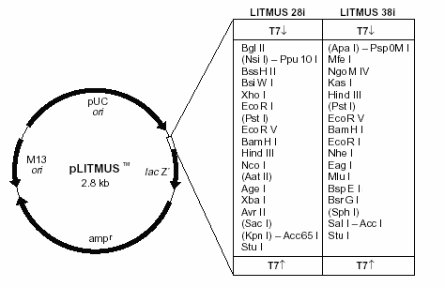
Some enzymes do not cut well when the site is near the end of linear DNA
Enzyme | Base pairs from End | %Cleavage Efficiency | Vector | Initial Cut
AatII | 3 2 1 | 88 100 95 | LITMUS 29 LITMUS 28 LITMUS 29 | NcoI NcoI PinAI
Acc65I | 2 1 | 99 75 | LITMUS 29 pNEB193 | SpeI SacI
AflII | 1 | 13 | LITMUS 29 | StuI
AgeI | 1 1 | 100 100 | LITMUS 29 LITMUS 29 | XbaI AatII
ApaI | 2 | 100 | LITMUS 38 | SpeI
AscI | 1 | 97 | pNEB193 | BamHI
AvrII | 1 | 100 | LITMUS 29 | SacI
BamHI | 1 | 97 | LITMUS 29 | HindIII
BglII | 3 | 100 | LITMUS 29 | NsiI
BsiWI | 2 | 100 | LITMUS 29 | BssHII
BspEI | 2 1 | 100 8 | LITMUS 39 LITMUS 38 | BsrGI BsrGI
BsrGI | 2 1 | 99 88 | LITMUS 39 LITMUS 38 | SphI BspEI
BssHII | 2 | 100 | LITMUS 29 | BsiWI
EagI | 2 | 100 | LITMUS 39 | NheI
EcoRI | 1 1 1 | 100 88 100 | LITMUS 29 LITMUS 29 LITMUS 39 | XhoI PstI NheI
EcoRV | 1 | 100 | LITMUS 29 | PstI
HindIII | 3 2 1 | 90 91 0 | LITMUS 29 LITMUS 28 LITMUS 29 | NcoI NcoI BamHI
NEB web site: https://www.neb.com/tools-and-resources/usage-guidelines/cleavage-close-to-the-end-of-dna-fragments

Slide 64
RNA transfers for the northern blot look pretty good – RNA intact and the amount expected

Slide 65
Last Lecture
Cytosine and adenosine methylation in DNA – why does it matter?
Can inhibit the DNA cleavage activity of restriction endonucleases used in the lab
  Check the NEB catalog for specific enzyme sensitivity to methylation
Can result in low efficiency cloning of foreign DNA due to enzymatic degradation of the modified/unmodified DNA
  Check your bacterial host genotype status of the Hsd (EcoK) genes and the Mrr, McrA and McrB endonuclease genes in the NEB catalog or the web site http://www.openwetware.org/wiki/E._coli_genotypes
Can result in low efficiency cloning of foreign DNA due to DNA replication arrest
  Check your bacterial host genotype status of the Dam and Dcm methylase genes in the NEB catalog or the web sit:
  http://www.openwetware.org/wiki/E._coli_genotypes
Use of DNA Methylases in the Recombinant DNA Lab
Use to prevent unwanted DNA cleavage during your cloning experiment
  For instance, to block cleavage at internal sequences of your insert DNA when you use synthetic dsDNA linkers containing the same site for cloning

Slide 66
Last Lecture
Types of restriction endonuclease recognition and cleavage sequences
Complete or interrupted palindromes, non-symmetrical sequences, cleavage within recognition sequence or at a distance from the recognition sequence
Blunt ends and 5’ and 3’ sticky ends
Nicking enzymes
Predicted vs actual DNA cleavage frequencies
Uses of restriction endonucleases
What are the chemical components of the reaction mixture and why is each important?
  For instance, Tris-HCl, divalent cation, dithiothreitol (DTT), etc.
What is the definition of a “unit” of activity for a restriction endonuclease?
DNA end effects - some enzymes cut very poorly when the recognition sequence is at the very ends of the DNA molecule
  May be an issue when cleaving a PCR product where you’ve incorporated a restriction site into the ends of the PCR primer
  May be an issue when cleaving plasmid DNA at adjacent sites in a polylinker (MCS)
    Check the NEB catalog for end effect sensitivity

Slide 67
Considerations about restriction enzyme use
DNA end affects. Some enzymes cut poorly at the end of DNA (NEB catalog). Practical consideration for double cleavage within a polylinker.
Star activity. Each enzyme has a recommended pH, salt concentration, temperature.
High pH, low salt, high glycerol or DMSO levels (relative to the optimized reaction conditions) can result in endonuclease cleavage at sites of “relaxed” DNA sequence preference (e.g., from G/AATTC to /AATTC for EcoRI).
See NEB catalog and note that when star activity is observed.

Slide 68
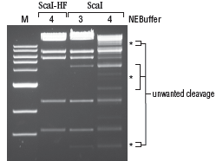
Star activity is due to the restriction enzyme cutting at DNA sequences in addition to the normal recognition site. This often occurs at sequences that contain subsets of the full sequence (e.g., ScaI site is AGTACT & star sites might include only the internal 4 bases (XGTACX).
ScaI-HF (high fidelity recombinant derivative of the ScaI enzyme without the star activity.

Slide 69
Considerations about restriction enzyme use
DNA end affects. Some enzymes cut poorly at the end of DNA (NEB catalog). Practical consideration for double cleavage within a polylinker.
Star activity. Each enzyme has a recommended pH, salt concentration, temperature. High pH, low salt, high glycerol or DMSO levels can allow cleavage at sites of “relaxed” sequence preference (e.g., from G/AATTC to /AATTC for EcoRI). See NEB catalog and note that when star activity is observer it is generally noted in the enzyme description.
Supercoiled vs linear DNA. Some enzymes, such as BsaAI (or SalI) cut supercoiled DNA very poorly but linear DNA well. Practical consideration for double cleavage within a polylinker – see SalI in NEB catalog.
https://www.neb.com/tools-and-resources/selection-charts/cleavage-of-supercoiled-dna

Slide 70
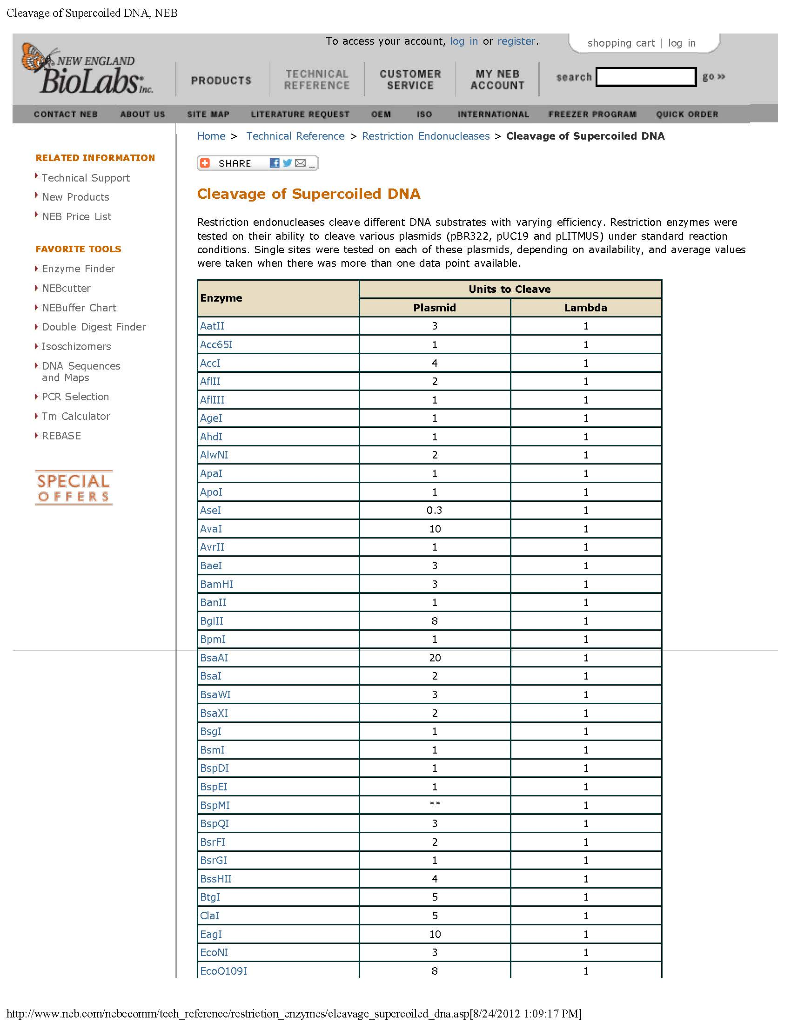

Slide 71
Chromosomal and plasmid DNA in living bacteria is negatively supercoiled (~ 1 negative supercoil per 40 turns of the helix). DNA gyrase is a topoisomerase II enzyme that uses ATP to add negative supercoils (this relaxes positive supercoils introduced by the cell) –it causes double-stranded DNA breaks followed by gyrase-mediated re-ligation that can help resolve (or form) plasmid dimers (mainly a function of topoisomerase IV). DNA gyrase facilitates the replication of DNA because the negative coils neutralize the positive supercoils introduced during opening of the double helix by DNA (or RNA) polymerase and helicase activities.
Topoisomerase I is a competing enzymatic activity that relaxes (unwinds) negative (or positive) supercoils it; it produces a single stranded nick in one strand to unwind and then reseals. Removes supercoiling to enhance separation of DNA strands upon completion of replication. Topo I activity (E. coli TopA gene product) does not require ATP.
https://www.youtube.com/watch?v=T06lo8T8Pmw

Slide 72
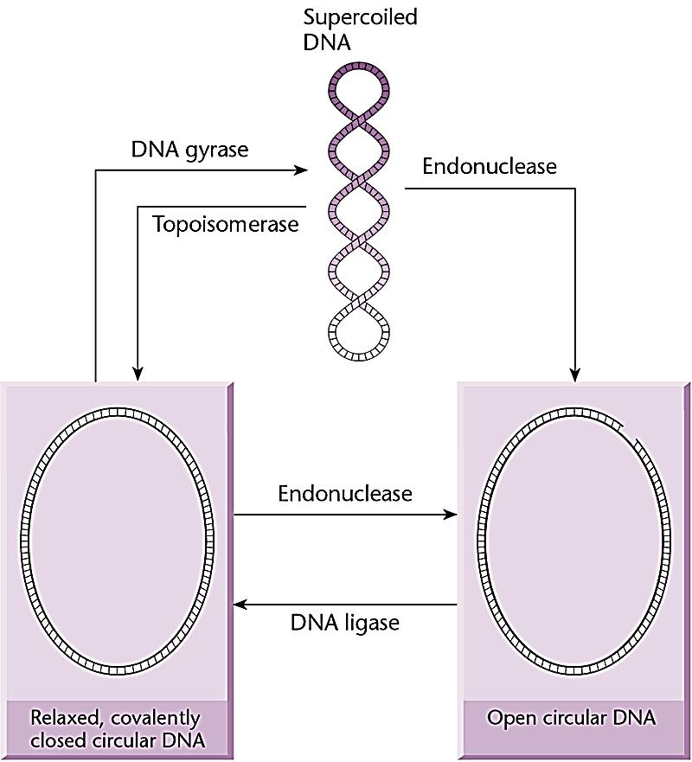
Class II topo + ATP; produces neg. supercoils during replication
I
E. coli topA, no ATP
WRONG! The endonuclease shown here introduces a gap in one strand –base pairs are lost. Nicked circles have only a break in the phosphodiester linkage –no loss of DNA sequence

Slide 73
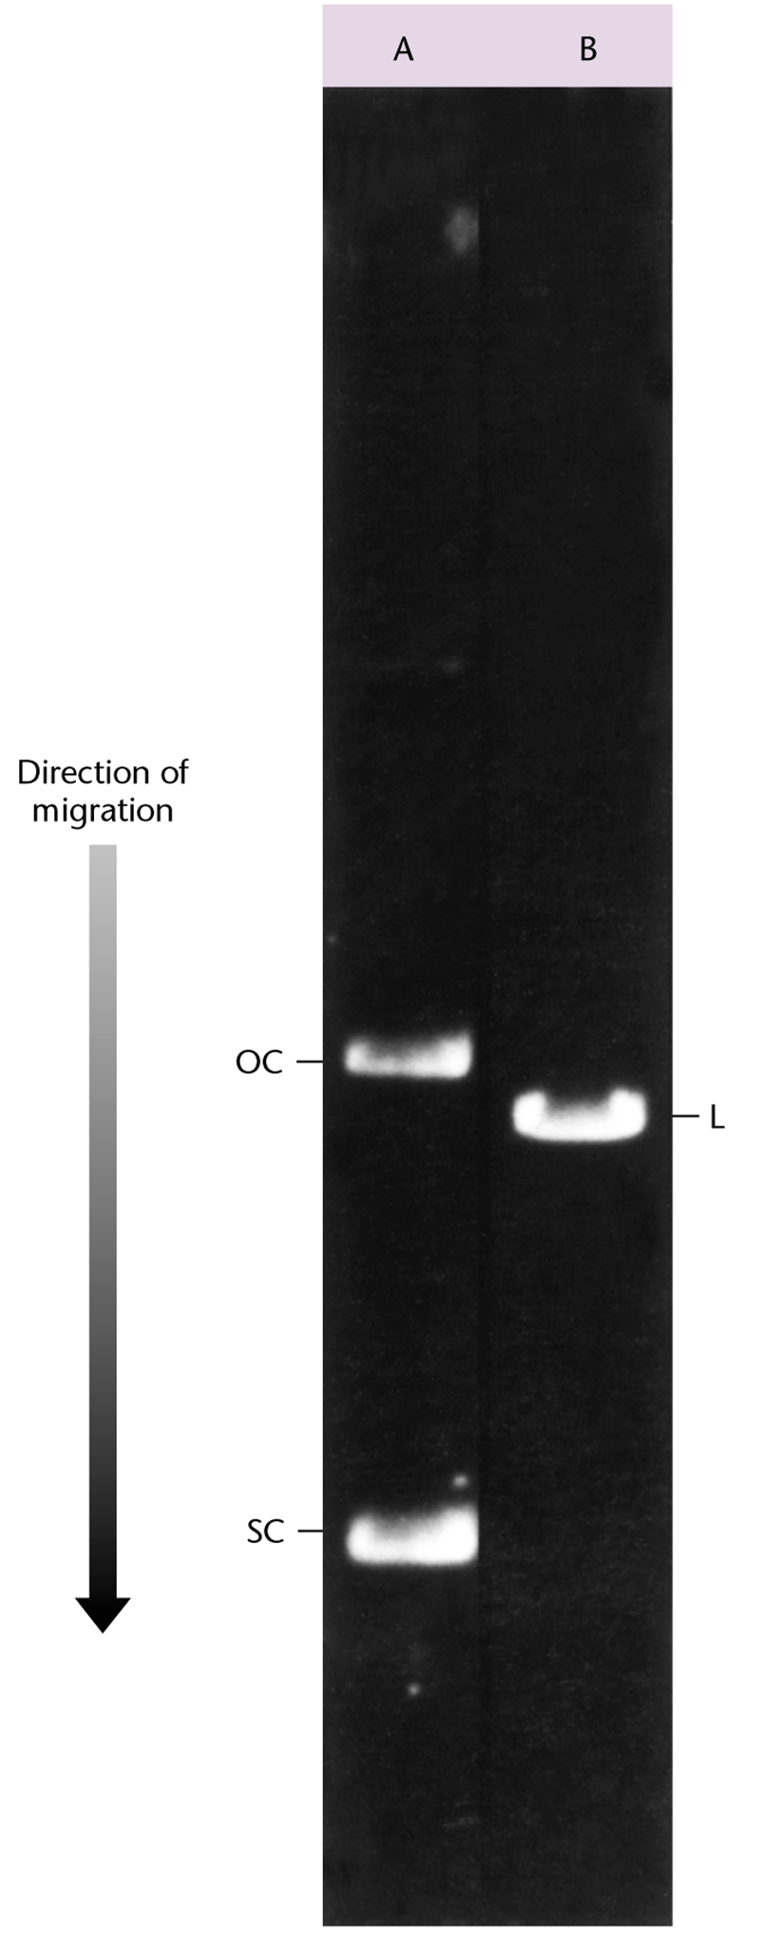
A = uncut plasmid showing the supercoiled (SC) and open circular forms as these migrate in an agarose gel.
B = DNA identical to A but linearized by a restriction endonuclease
The bands are imaged under short wavelength UV light after EtBr staining.
Maximum binding approximately 1 EtBr molecule per 2 bp linear DNA – less for supercoiled DNA

Slide 74
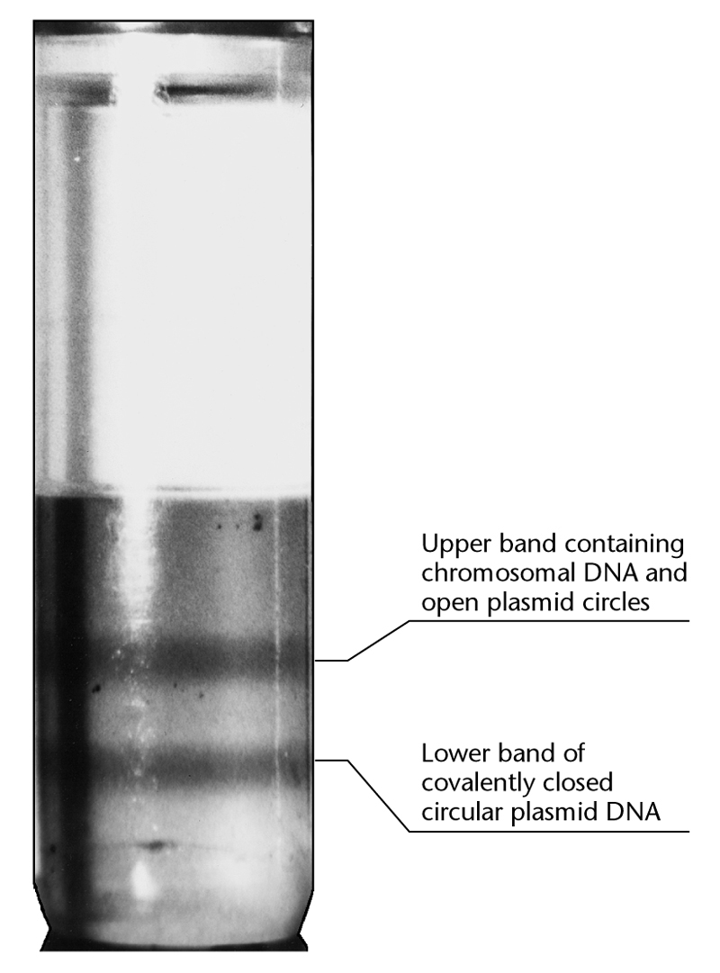
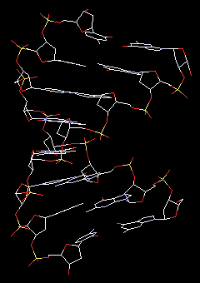
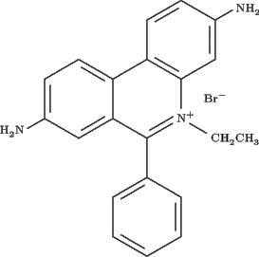
Supercoiling reduces the amount of EtBr that can bind DNA. EtBr binding makes DNA less dense.
Consequently, supercoiled DNA sediments further into a CsCl density gradient (reaches a greater buoyant density).
Good way to separate linear eukaryotic chromosomal DNA from plasmids or other circular DNAs (e.g., mitochondrial DNA, certain viral DNAs).

Slide 75
Considerations about restriction enzyme use
DNA end affects. Some enzymes cut poorly at the end of DNA (NEB catalog). Practical consideration for double cleavage within a polylinker.
Star activity. Each enzyme has a recommended pH, salt concentration, temperature. Alterations in either (e.g., high pH, low salt), high glycerol, or DMSO can allow cleavage at sites of “relaxed” sequence preference (e.g., from G/AATTC to /AATTC for EcoRI). See NEB catalog and note that when star activity is observer it is generally noted in the enzyme description.
Supercoiled vs linear DNA. Some enzymes, such as SalI cut supercoiled DNA very poorly but linear DNA well. Practical consideration for double cleavage within a polylinker – see SalI & NEB catalog.
Site bias. Sequence context can make a difference e.g., EcoRI or HindIII within λ DNA – for each enzyme there are multiple sites where 10 fold differences exist between the “fastest” to “slowest” cleavage rates.
  Other enzymes require 2 identical restriction site sequences, one acts as an allosteric effector site the other the cleavage site (e.g., NaeI) see catalog -https://www.neb.com/tools-and-resources/usage-guidelines/site-preferences

Slide 76
Considerations about restriction enzyme use
DNA end affects. Some enzymes cut poorly at the end of DNA (NEB catalog). Practical consideration for double cleavage within a polylinker.
Star activity. Each enzyme has a recommended pH, salt concentration, temperature. Alterations in either (e.g., high pH, low salt), high glycerol, or DMSO can allow cleavage at sites of “relaxed” sequence preference (e.g., from G/AATTC to /AATTC for EcoRI). See NEB catalog and note that when star activity is observer it is generally noted in the enzyme description.
Supercoiled vs linear DNA. Some enzymes, such as SalI cut supercoiled DNA very poorly but linear DNA well. Practical consideration for double cleavage within a polylinker – see SalI & NEB catalog.
Site bias. Sequence context can make a difference e.g., EcoRI or HindIII within λ DNA – for each enzyme there are multiple sites where 10 fold differences exist between the “fastest” to “slowest” cleavage rates. Other enzymes require 2 identical restriction site sequences, one acts as an allosteric effector site the other the cleavage site (e.g., NaeI) see catalog -https://www.neb.com/tools-and-resources/usage-guidelines/site-preferences
Survival of the enzyme under reaction conditions. Do longer incubations increase the amount of DNA cut?

Slide 77
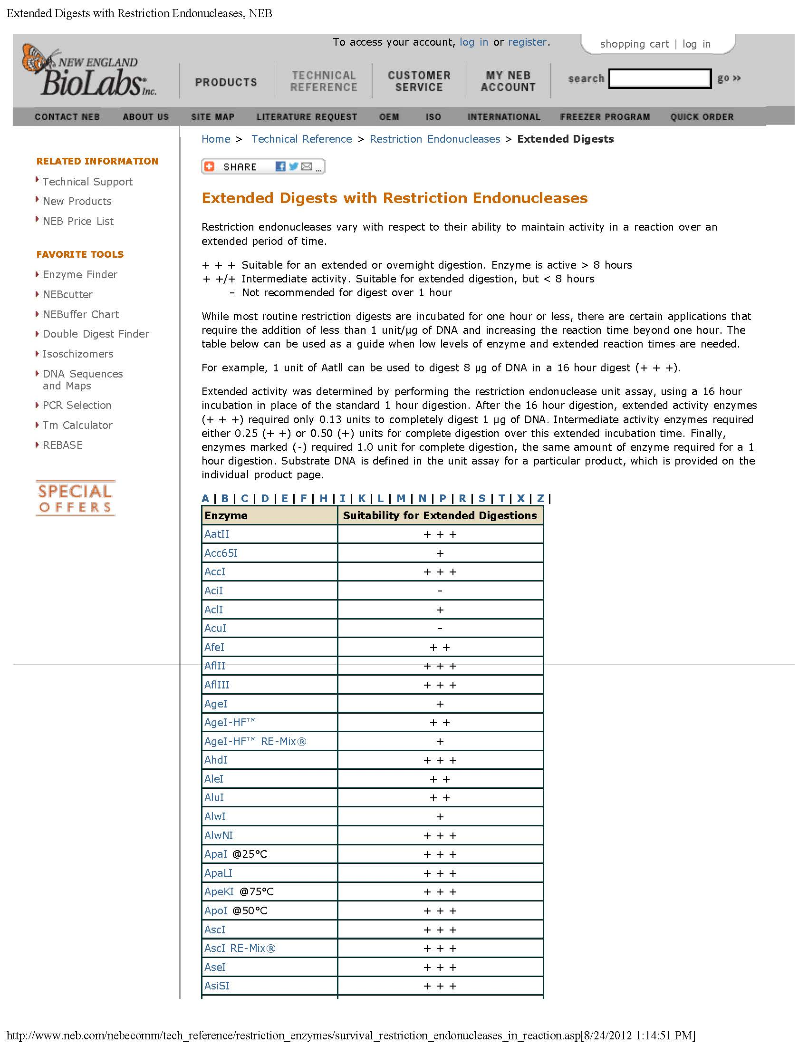
1 unit/1 hour = standard assay.
A 16 hour assay performed with 1 ug of DNA and fractions of a unit to determine where the enzyme “keeps working” after the first hour.
Units required for complete cleavage
1.0 -
0.5 +
0.25 ++
0.13 +++
Note that cleavage rate also depends on the concentration of DNA and enzyme since these must find each other before the chemistry happens.

Slide 78
Considerations about restriction enzyme use
DNA end affects. Some enzymes cut poorly at the end of DNA (NEB catalog). Practical consideration for double cleavage within a polylinker.
Star activity. Each enzyme has a recommended pH, salt concentration, temperature. Alterations in either (e.g., high pH, low salt), high glycerol, or DMSO can allow cleavage at sites of “relaxed” sequence preference (e.g., from G/AATTC to /AATTC for EcoRI). See NEB catalog and note that when star activity is observer it is generally noted in the enzyme description.
Supercoiled vs linear DNA. Some enzymes, such as SalI cut supercoiled DNA very poorly but linear DNA well. Practical consideration for double cleavage within a polylinker – see SalI & NEB catalog.
Site bias. Sequence context can make a difference e.g., EcoRI or HindIII within λ DNA – for each enzyme there are multiple sites where 10 fold differences exist between the “fastest” to “slowest” cleavage rates. Other enzymes require 2 identical restriction site sequences, one acts as an allosteric effector site the other the cleavage site (e.g., NaeI) see catalog.
Survival of the enzyme under reaction conditions. Do longer incubations increase the amount of DNA cut?
Heat inactivation. Often may be desired to “remove” restriction enzyme to prevent cleavage in a later stage of your experiment. This can always be done by phenol extraction followed by ethanol precipitation – but sometimes it is possible to simply heat-inactivate the enzyme.

Slide 79
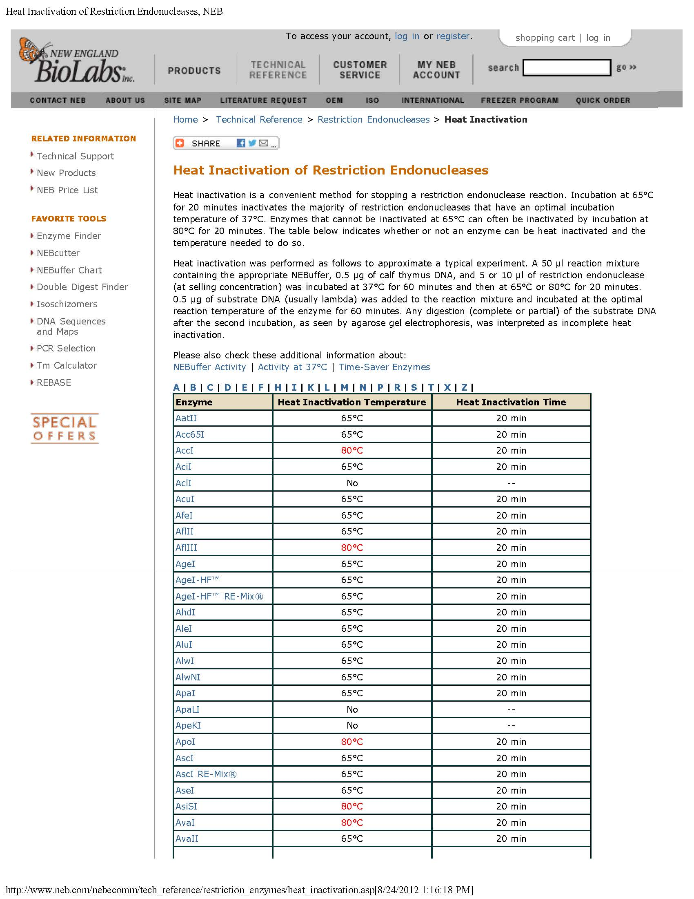

Slide 80
Examples of nuclease activities (substrates, products & uses)
Double stranded endodeoxyribonuclease: standard restriction enzymes, e.g., EcoRI, HindIII
Single stranded endoribo (& deoxyribo) nuclease: S1 nuclease, Mung bean nuclease – blunting DNA ends; mRNA characterization

Slide 81
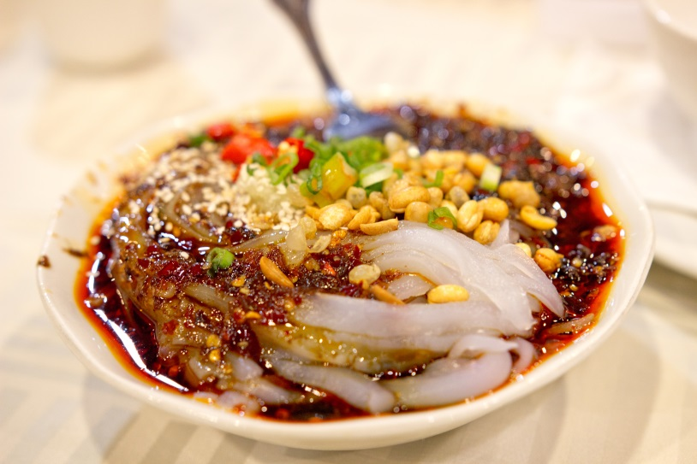




Mung beans – yes, you’ve seen these before
https://sproutman.com/wp-content/uploads/2013/05/Mung-Shoots-on-Deck2-e1405539588277.jpg

Slide 82

Mung Bean Nuclease A single-strand specific DNA and RNA endo/exo nuclease which will degrade single-stranded extensions from the ends of DNA and RNA molecules, leaving blunt, ligatable ends. S1 nuclease is another enzyme that acts similarly.
Applications:
- Removal of single-stranded extensions (3'and 5')
- RNA Transcript mapping
Cleavage of hairpin loops in DNA or RNA
5’
What would this molecular look like after mung bean nuclease treatment?
3’
http://en.wikipedia.org/wiki/Stem-loop

Slide 83
1. 5’ extension: EcoRI
Use mung bean nuclease to make any two restriction sites compatible with ligase.
2. 3’ extension: KpnI
3. Blunt & ligate
What would the
Eco/Hind DNA junction
look like after MB & ligase?
5’…GC…3’
3’…CG…5’
DNA “ends” left after EcoRI and KpnI cleavage cannot be joined by DNA ligase since the singles stranded extensions do not base pair.
However, the single strands can be removed by mung bean nuclease and the “blunt or flush” ends ligated together.
This works with any pair of restriction enzymes – all sticky ends can be made blunt then ligated together.

Slide 84

Mung Bean Nuclease: Rejoining of certain blunt ends creates a new restriction site (here the NcoI from HindIII)
NEB catalog
A) Molecular weight standard (λ HindIII digest)
B) M13mp8 (supercoiled)
C) As in B after incubation with NcoI
D) As in B after incubation with HindIII
E) As in D after incubation with Mung Bean Nuclease
F) As in E after incubation with T4 DNA Ligase
G) As in F after incubation with NcoI
H) As in F after incubation with HindIII
5’CCAAGCTTGG3’
3’GGTTCGAACC5’
Original HindIII site
CCA AGCTTGG
GGTTCGA ACC
Cut with HindIII
5’CCATGG3’
3’GGTACC5’
After mung bean nuclease & T4 ligase, creates a new NcoI site.

Slide 85

Double stranded exo-deoxyribonucelase: Bal 31 (leaves mixture of blunt & staggered ends); making nested deletions of DNA.
Exonuclease III (requires a double-stranded template but removes only one of the two strands because it works 3'->5‘; 3’ extended ssDNAs are not cleaved); making single stranded DNA for sequencing or mutagenesis. Does not move through a phosphothioate linkage or a 3’ single-stranded extension. Combine this specificity with mung bean nuclease to make a series of unidirectional deletions within a gene.
Double stranded endodeoxyribonuclease: EcoRI (very sequence specific), DNase I (little or no DNA sequence specificity), micrococcal nuclease (RNA and DNA, little no specificity but calcium dependent)
Uses?

Slide 86
Wednesday Oct 11: Exam 1 & notebooks due for grading. You will have entire lab period to complete the exam.
The exam will have open book (NEB catalog only) and closed book sections.
Questions will be taken from:
a) assigned readings (NEB catalog, textbook, handouts, class web page),
b) lab protocols & results,
c) lab discussions and Friday lectures.
Be smart, review the posted old exam – some questions will be very similar.

Slide 87
Last Two Weeks
Radiation safety lecture – Powerpoint posted, review the entire file (required training) but will be tested on only the first 30 slides
Restriction endonuclease conditions
  Star activity
  Cutting supercoiled vs linear DNA
  Site bias
  Survival of enzyme under standard reaction conditions
  Heat inactivation
Mung bean nuclease – single stranded DNase and RNase
Exonuclease III (Exo III) – dsDNA requirement, cuts 3’ -> 5’ to leave single-stranded product;
    a. Combination of Exo III plus mung bean nuclease & T4 DNA ligase to make unidirectional or bi-directional deletions
I was asked to review the Exo III deletion strategy, so….

Slide 88
1. 5’ extension: EcoRI
2. 3’ extension: KpnI
3. Blunt: SmaI
First off, recall that every restriction enzyme leaves one of three types of ends – only the 5’ extension and blunt ends are substrates for exo III.
Why?
Exo III requires that the 3’ end of the cut DNA to be base paired (i.e., double stranded) in order to initiate the exonuclease activity!

Slide 89
*If a ds endonuclease leaving blunt or 5’ extensions is used, the deletions will be bi-directional (left & right)
If two enzyme used, one leaving 5’ extension and one a 3’ extension, deletions only from site with the 5’ extension;
Filling in” a 5’ extension sticky end with phosphothioate (S-containing) nucleotide with DNA polymerase also blocks exo III cleavage from that restriction endonuclease cleavage site site

Slide 90
Enzymes that copy nucleic acids: Polymerases – all synthesize in a 5'->3' direction, differ in their substrate specificity, salt requirements, pH and heat optima & tolerance, Km for nucleotides & substrate, error rate and in whether or not the same protein has additional enzymatic activities.
DNA-dependent DNA polymerases copy DNA->DNA; standard replicative enzymes. Examples: E. coli DNA polymerase I (complete (holo) enzyme or Klenow fragment); bacterial viral polymerases T4 or T7 DNA polymerase; thermostable polymerases such as Taq DNA polymerase. Enzymes chosen because of desired characteristics.
For instance, the high heat tolerance of Taq DNA polymerase from Thermus aquaticus (or the similar enzymes Vent polymerase, Pfu polymerase, etc) allow one to perform the polymerase chain reaction (PCR) through multiple cycles of DNA denaturation at 92C – 98ºC.
The presence of ancillary exonuclease activities (5‘->3' and/or 3’->5') may also guide selection (e.g., T4 DNA polymerase has a more active 3'-5' exonuclease activity than E. coli DNA polymerase making it good for removing 3’ extensions & enhancing “fidelity”; the Klenow fragment lacks the 5'-3' exonuclease of the complete enzyme making it valuable for “fill-in” reactions to blunt 5’ extensions but not for “nick translations” done with the full enzyme).
Selection of enzymes based on additional properties for a particular application, see: https://www.neb.com/tools-and-resources/selection-charts/dna-polymerase-selection-chart

Slide 91
RNA-dependent DNA polymerase (reverse transcriptase; telomerase): Enzymes that copy single stranded RNA into DNA (leaving, in vitro, a DNA/RNA hybrid). Examples: Murine or avian reverse transcriptase; useful in making cDNA for cloning or gene expression

Slide 92

“Reverse transcriptase” RNA-dependent DNA polymerase used to make cDNA
Enzyme requires a ds region to initiate – so, mRNA must be “primed” by hybridization of a synthetic oligonucleotide
Here, oligo dT is annealed to the poly A tail (but sequence specific oligonucleotides can also be used).
Mol Biol. Cell
Copyright © 2002, Bruce Alberts, Alexander Johnson, Julian Lewis, Martin Raff, Keith Roberts, and Peter Walter; Copyright © 1983, 1989, 1994, Bruce Alberts, Dennis Bray, Julian Lewis, Martin Raff, Keith Roberts, and James D. Watson

Slide 93

Why would you want to prepare cDNA? That is, what would you use it for?
Clontec Inc. web site

Slide 94
RNA dependent DNA polymerase (reverse transcriptase; telomerase): Enzymes that copy single stranded RNA into DNA (leaving, in vitro, a DNA/RNA hybrid). Examples: Murine or avian reverse transcriptase; useful in making cDNA for cloning or gene expression (what about telomerase?)
DNA dependent RNA polymerases: Standard transcriptional enzymes that produce a single stranded RNA copy from a double stranded DNA template. E. coli RNA polymerase, T3 or T7 bacteriophage RNA polymerase. Useful, for instance, for making radiolabeled RNA hybridization probe in vitro or to use to program an in vitro translation system

Slide 95



Which phosphorous on UTP do you think was labeled?
This is what we didin the BIO 510 lab
Epicentre catalog web site

Slide 96
But why would you want to make RNA?
- Strand-specific hybridization probes for northern blots (what we are doing in lab), microarrays, or in situ (in cell) detection of cellular nucleic acids (often made using a NTP with a florescent label, e.g., cy3, rather than ³²⁻P).
- Use to study intrinsic properties of the RNA (e.g., define the catalytic subunits of a ribozyme or to biochemically test structural predictions originating from computational studies).
- Use as a template for protein synthesis (e.g., in vitro translation) or as a substrate for in vitro biochemistry (e.g., studies on the mechanism of pre-mRNA splicing, mRNA polyadenylation, or mRNA degradation)
- Use as a tool for RNA-based “knockdown” experiments (e.g., targeted degradation of specific cellular mRNAs by RNAi

Slide 97

RNase Protection Assay
Cellular mRNA is hybridized with an artificial single-stranded complementary RNA, which has to be specifically labeled, usually with ³²P.
After the formation of double-stranded complexes, all single-stranded RNA molecules are eliminated by RNase degradation (e.g., RNase A or S1 – typically NOT mung bean nuclease).
Use to monitor RNA expression levels or define the structure
Molecular Biomethods Handbook;
Humana Press Inc , Totowa, NJ
Good for measuring one or a few transcripts – for transcriptome changes do microarray or RNAseq

Slide 98

B. Original autoradiography presenting the untreated probe (1) the results of a TGFa-specific RPA done with bovine mammary total RNA (2), and the background control (3-6). Increasing amounts of sense TGFcr-RNA-standard (4–6: 0.25,0.5,5 pg) were separated on 15% PAGE RNA
Such quantification and mapping experiments now more often done by rtPCR or RNA sequencing rather than by S1 analysis
Questions that can be answered by this approach:
How much of a particular RNA is present in a preparation (as above)?
Were is the 5’ end or the 3’ end of a particular mRNA?
Which possible splice junctions (or poly A sites) are used?
Molecular Biomethods Handbook
Humana Press Inc , Totowa, NJ
10.1007/978-1-59259-642-3_5
Ralph Rapley and John M. Walker

Slide 99

RNA Structure Mapping – the use of structure-sensitive RNases to determine single-stranded and doubles-stranded regions within a structured RNA.
One of the first questions asked about an RNA molecule's secondary structure is, "Which regions are double-stranded?"
RNase V1, preferentially cleaves between nucleotides in double-stranded regions of the RNA while Rnase A and T1 cut ssRNA only (see specificity).
RNA is first end-labeled with 32P (e.g., with T4 polynucleotide kinase and [gamma-32P]ATP to label the 5' end or with RNA ligase and [alpha-32P]ATP to label the 3' end).
Partially digest with RNase V1, and then the fragments are resolved on a denaturing polyacrylamide gel. To help identify the cleavage site locations, a "ladder" generated by alkaline hydrolysis or enzymatic digestion is run on the same gel.
To identify or confirm unpaired RNA regions (e.g., loop structures), nucleases selective for single-stranded RNA regions are useful. RNase A, which cleaves 3' to single-stranded C and U residues, and RNase T1, which cleaves single-stranded G residues.
Applied Biosystems, Ambion Tech note

Slide 100



.
RNase VI –dsRNA specific
RNase TI – ssRNA (G) specific
RNase A – ssRNA (Py) specific
Hypothetical RNase digestion data from the "Test" RNA sequence. This "gel" shows the cleavage pattern that would be expected if the "test"
RNA 5' radiolabeled, digested with nucleases and then separated by denaturing polyacrylamide gel electrophoresis.
Lane 1 (C+U) represents cleavage of the phosphodiester bond under denaturing conditions by RNase A 3’ of C and U residues. Control – shows all C &U positions
Lane 2 (G) shows cleavage under denaturing conditions by RNase T1 at all G residues. Control-shows all G’s
Lanes 3-5 represent limited cleavage of the native folded RNA (with natural secondary structure) by RNases VI (ds) and T1(ss) - shows which areas are ds and which are ss.
Applied Biosystems, Ambion Tech note.

Slide 101
Why is RNA secondary structure important?
Secondary structure determines the availability of bases for RNA and protein interaction.
RNA accessibility and structure regulates cellular biochemistry, including transcriptional attenuation (bacteria), nuclear import and export of eukaryotic RNAs, RNA splicing, RNA translation into protein, and RNA degradation.
RNA structure is regulated through the association of specific proteins and trans-acting RNAs.
The regulation of RNA secondary structure is a widespread and critical means of modulating eukaryotic (yeast -> human) gene expression.

Slide 102
RNA-dependent DNA polymerase (reverse transcriptase; telomerase): Enzymes that copy single stranded RNA into DNA (leaving, in vitro, a DNA/RNA hybrid). Examples: Murine or avian reverse transcriptase; useful in making cDNA for cloning or gene expression
DNA-dependent RNA polymerases: Standard transcriptional enzymes that produce a single stranded RNA copy from a double stranded DNA template. E. coli RNA polymerase, T3 or T7 bacteriophage RNA polymerase. Useful, for instance, for making radiolabeled RNA hybridization probe in vitro or to use to program an in vitro translation system
Template independent polymerase: Terminal deoxynucleotide transferase – Random deoxynucleotide addition to 3’ ends of DNA during V(D)J recombination of human immunoglobulin genes. This randomization of DNA plays a crucial role in the evolution and adaptation of the vertebrate immune system.
Terminal transferase can be used in cloning applications to add a homopolymer “tail” to a cDNA or a PCR product. Can also be used with radiolabeled nucleotides to “end-label” a DNA. Other enzymes

Slide 103


TUNEL assay used to detect apoptosis (programmed cell death) in cells and tissues.
Addition of the deoxythymidine analog 5‑bromo‑2´‑deoxyuridine 5´‑triphosphate
(BrdUTP) to the TdT reaction serves to label the break sites.
Once incorporated into the DNA, BrdU can be detected by an anti‑BrdU antibody.
This method of labeling DNA breaks is referred to as Terminal Deoxynucleotide Transferase BrdUTP Nick End Labeling, or TUNEL assay (Invitrogen web site)
Kang et al., Korean Med Sci. 2006; low dose radiation on rat brains under various conditions

Slide 104
Other template independent polymerase enzymes
Poly A polymerase for mRNA maturation (can be used in the lab for homopolymer tailing/labeling of RNA), and
tRNA nucleotidyltransferase CCA addition to t-RNA 3’ ends.

Slide 105
RNA-dependent DNA polymerase (reverse transcriptase; telomerase): Enzymes that copy single stranded RNA into DNA (leaving, in vitro, a DNA/RNA hybrid). Examples: Murine or avian reverse transcriptase; useful in making cDNA for cloning or gene expression
DNA-dependent RNA polymerases: Standard transcriptional enzymes that produce a single stranded RNA copy from a double stranded DNA template. E. coli RNA polymerase, T3 or T7 bacteriophage RNA polymerase. Useful, for instance, for making radiolabeled RNA hybridization probe in vitro or to use to program an in vitro translation system
Template independent polymerase: Terminal deoxynucleotide transferase – Random deoxynucleotide addition to 3’ ends of DNA during V(D)J recombination. This randomization of DNA plays a crucial role in the evolution and adaptation of the vertebrate immune system. Terminal transferase can be used in cloning applications to add a homopolymer “tail” to a cDNA or a PCR product. Can also be used with radiolabeled nucleotides to “end-label” a DNA. Poly A polymerase for mRNA maturation (can be used for homopolymer tailing of RNA), tRNA nucleotidyltransferase CCA addition to t-RNA 3’ ends.
RNA-dependent RNA polymerase: RNA from RNA. Viral enzymes for transcription & replication. Generally not commercially available. Example: VSV L-protein; C. elegans naturally has much of this activity & this enhances the RNAi response (we will discuss this later in the semester).

Slide 106
Kinases: Add phosphate to the 5' hydroxyl of DNA or RNA (double or single stranded). Example, T4 polynucleotide kinase.

Slide 107



Nucleic Acid Kinase: Adds the terminal (ᵞ “gamma” phosphate to the 5' hydroxyl of DNA or RNA (double or single stranded). Example, T4 polynucleotide kinase.
http://66.155.211.155/nebecomm/products_intl/productM0201.asp
Used to phosphorylate the ends of PCR products prior to cloning; to label the 5’ ends of DNA or RNA for use as hybridization probes or for structure mapping.
http://www.perkinelmer.com/resources/technicalresources/applicationsupportknowledgebase/radiometric/invitro_kinase.xhtml
https://www.neb.com/applications/dna-modification/dna-end-modification/dna-phosphorylation

Slide 108

Binding site for DNA 5’ end
Binding site for ATP
T4 PNK catalyzes the phosphate transfer by juxtaposing the reactive 5’-OH end of DNA/RNA and ATP and in the right chemical environment

Slide 109
Last Week
Reverse Transcriptase – RNA dependent DNA polymerase
  cDNA synthesis
  Uses of cDNA in molecular biology
2) DNA dependent RNA polymerases – example of T7 RNA polymerase
  In vitro transcription
  Nuclease protection assay to measure mRNA abundance, alternative splicing, 5’ and 3’ ends
  Use of structure sensitive ribonucleases to determine the secondary structure of RNA
3) Template independent polymerase: Example of terminal deoxynucleotide transferase
a. Use for 3’ end labeling of DNA
b. TUNEL assay for apoptosis
c. Other activities including poly A polymerase and tRNA nucleotidyltransferase
4) Nucleic acid kinases – example T4 polynucleotide kinase, use in 5’ end labeling of DNA; role of ATP in kinase reaction (compared with T4 DNA ligase)

Slide 110
NEXT WEEK: Friday October 13 Tseten Yeshi, Ph.D., V.P. Research and Development Hera BioLabs Inc
Last year, this was a very fast-paced presentation – you need to prepare.
Required reading: https://www.herabiolabs.com/technology/humanized-rodents/
Pay special attention to the sections (hot links) on:
Humanized immune system rats
Genome Editing Technologies
PiggyBac™
CRISPR
TALEN
.

Slide 111


Broad-spectrum Phosphatase: Alkaline Phosphatase nonspecifically catalyzes the dephosphorylation of 5´ and 3´ ends of DNA and RNA phosphomonoesters. Also hydrolyses ribo-, as well as deoxyribonucleoside triphosphates (NTPs and dNTPs). Examples, calf intestinal alkaline phosphatase, bacterial alkaline phosphatase, shrimp alkaline phosphatase – Note: cannot remove inverted guanosine “cap” of mRNA.
http://www.ibch.ru/biotech/eng/products.html
http://www.escience.ws/b572/L6/L6.htm
Uses: Removal of 5’ phosphates prior to T4 polynucleotide kinase labeling;
Removal of vector 5’ phosphate to prevent vector self ligation in cloning; some also remove phosphate from protein (lambda phosphatase)
https://www.neb.com/tools-and-resources/selection-charts/protein-phosphatase-specificity-chart

Slide 112
Kinases: Add phosphate to the 5' hydroxyl of DNA or RNA (double or single stranded). Example, T4 polynucleotide kinase.
Broad-spectrum Phosphatase: Remove 5' phosphates from RNA and DNA - some work with protein. Example, calf intestinal alkaline phosphatase, bacterial alkaline phosphatase, shrimp alkaline phosphatase.
Recombinases – (Cre, Flp) – protein enzymes that promote site-specific recombination - helpful in molecular genetics (targeted “knockouts”, knock-ins) and also for “ligase-free” cloning.
http://www.cf.ac.uk/biosi/staffinfo/ehrmann/tools/Recognition.htm

Slide 113
Recombinases – (Cre, Flp) – enzymes that promote site-specific recombination - helpful in molecular genetics for targeted “knockouts” (deleting gene) & “knock-ins” (adding DNA or replacing gene) and also for “ligase-free” cloning (e.g., the Gateway system).
The basic 34 bp Flp target site is composed of two 13 bp inverted arms and a central core spacer: ^{5'}GAAGTTCCTATTCtctagaaaGtATAGGAACTTC^{3‘}
Example Alternate LoxP Sites [19] – for CRE recombinase
Name | 13bp Recognition Region | 8bp Spacer Region | 13bp Recognition Region
Wild-Type | ATAACTTCGTATA | ATGTATGC | TATACGAAGTTAT
Lox 511 | ATAACTTCGTATA | ATGTATaC | TATACGAAGTTAT
Lox 5171 | ATAACTTCGTATA | ATGTgTaC | TATACGAAGTTAT
Lox 2272 | ATAACTTCGTATA | AaGTATcC | TATACGAAGTTAT
M2 | ATAACTTCGTATA | AgaaAcca | TATACGAAGTTAT
M3 | ATAACTTCGTATA | taaTACCA | TATACGAAGTTAT
M7 | ATAACTTCGTATA | AgaTAGAA | TATACGAAGTTAT
M11 | ATAACTTCGTATA | aGATAgaa | TATACGAAGTTAT
Lox 71 | taccgTTCGTATA | NNNTANNN | TATACGAAGTTAT
Lox 66 | ATAACTTCGTATA | NNNTANNN | TATACGAAcggta

Slide 114

Creation of a gene targeting vector and transfer in to mouse embryonic stem cells.
Positive selection in tissue culture:
Resistance to neomyosin-like toxic compounds such as G418 (Gentamicin).
Negative selection:
The herpes simplex virus encoded thymidine kinase (HSVtk) enzyme phosphorylates certain nucleoside analogs (e.g. ganciclovir, an anti-herpes virus drug) converting them to toxic DNA replication inhibitors. This reduces the recovery of random chromosomal integrants.
Use recombinant DNA techniques add loxP sites flanking the sequence to be removed on a cloned copy of the gene.
The cloned DNA is transfected into embryonic stem cells where normal homologous recombination creates a modified chromosome: note positive & negative selection

Slide 115


The modified embryonic stem cells are injected into mouse embryos and allowed to develop. A subset of the mosaic offspring will have the floxed gene in the germline cells. By mating siblings of these offspring, you can create mice homozygous for the floxed allele (or with one floxed allele and one null allele).
These floxed animals are then are mated with Cre-expressing mice to generate offspring in which the DNA between the lox P sites is deleted and the phenotype can be observed.
Lots of recombinant model systems (e.g., Drosophila, Zebrafish, mouse, Arabidopsis) are available with either Cre or FLP expressed in a tissue-specific, developmental or drug-dependent fashion allowing one to either delete a gene or activate a gene in a conditional or target restricted fashion.

Slide 116

CRISPR-Cas9 – more efficient means of engineering complex genomes
Useful to:
1) delete genes from chromosomal DNA
2) correct mutations within chromosomal genes
3) create gene-fusions to add novel features to existing genes
https://www.youtube.com/watch?v=O3e2_Ctty_M

Slide 117
Kinases: Add phosphate to the 5' hydroxyl of DNA or RNA (double or single stranded). Example, T4 polynucleotide kinase.
Broad-spectrum Phosphatase: Remove 5' phosphates from RNA and DNA - some work with protein. Example, calf intestinal alkaline phosphatase, bacterial alkaline phosphatase, shrimp alkaline phosphatase.
Recombinases – (Cre, Flp) – enzymes that promote site-specific recombination - helpful in molecular genetics (targeted “knockouts”, knock-ins) and also for “ligase-free” cloning. The basic 34 bp Flp target site is composed of two 13 bp inverted arms and a central core spacer: ^{5'}GAAGTTCCTATTCtctagaaaGtATAGGAACTTC^{3'}
http://www.cf.ac.uk/biosi/staffinfo/ehrmann/tools/Recognition.htm
Proteases – can be useful in releasing epitope tags used for affinity purification (Factor X, TEV), in removing protein from nucleic acids (proteinase K), or in generating discrete peptides for mass spectrometry (trypsin).

Slide 118
Proteases
General proteases with limited sequence specificity useful for:
removing protein from nucleic acid preparations used for cloning or analysis. Proteinase K (or endopeptidase K) cuts peptide bonds after hydrophobic amino acids (aliphatic, aromatic, other).
Generating discrete peptides for mass spectrometry.
  Trypsin cleaves peptides on the C-terminal side of lysine and arginine amino acid residues. Context is important: if a proline residue is on the carboxyl side of the cleavage site, the cleavage will not occur. If an acidic residue is on either side of the cleavage site, the rate of hydrolysis slows considerably.
  Chymotrypsin cuts at the C-terminal side of tryptophan, tyrosine, phenylalanine, leucine, and methionine.

Slide 119

Specificities
Proteinase K – cuts after aliphatic, aromatic and other hydrophobic amino acids
Elastase I - specific for Ala-Ala and Ala-Gly bonds
Chymotrypsin – cuts after tryptophan, tyrosine, phenylalanine, leucine, and methionine
Trypsin – cuts after lysine and arginine

Slide 120
Site-specific proteases useful in releasing epitope tags used for affinity purification
http://www.cf.ac.uk/biosi/staffinfo/ehrmann/tools/Recognition.htm
Sequence Specific Proteases
Tobacco etch virus protease (TEV):The seven-amino-acid recognition site for rTEV is Glu-Asn-Leu-Tyr-Phe-Gln-Gly with cleavage occurring between Gln and Gly. Certain variations on this consensus are allowed.
http://tools.lifetechnologies.com/content/sfs/manuals/10127017.pdf
Factor Xa protease: Factor Xa cleaves after the arginine residue in its preferred cleavage site Ile-(Glu or Asp)-Gly-Arg. It will sometimes cleave at other basic residues using a similar consensus, depending on the conformation of the substrate protein. https://www.neb.com/products/p8010-factor-xa-protease

Slide 121

Affinity tags are used to purify proteins and protein complexes. A protease site often sits between the epitope tag and the protein of interest
Protein organization (4-parts): Protein of interest-calmodulin binding domain peptide-TEV cleavage site-protein A peptide
Selection strategy: 1) Bind protein A to IgG agarose, wash then elute protein with TEV protease
Benefits: 1) affinity binding is very specific and tight, washes can be quite stringent 2) elutions are very gentle and most importantly, specific
Nat Biotechnol. 1999 Oct;17(10):1030-1032.

Slide 122
Last Week
Broad spectrum phosphatases
  Applications for 5’ end labeling DNA & cloning
Site-specific recombinases – Flp and Cre-lox
  Use for creating transgenic cell lines and animals
CRISPR-Cas 9 mediated genome engineering
General and site-specific proteases
  Removing protein contaminants; prepare peptides for proteomics, clipping off affinity tags

Slide 123
Measuring mRNA abundance
Northern blots, RNase mapping and quantitative reverse transcriptase PCR (rtPCR) are useful for detecting and quantifying RNAs in biological samples. These approaches are most useful when you are scoring a minor subset of the cells RNA (e.g., less than a few dozen transcripts)
What do you do when you want to assay the many thousands of RNAs in a cell to learn, for example, how gene expression differs
between a cancer cell and a normal cell?
cell/tissue/organism before and after viral infection?
cell/tissue/organism after exposure for a hormone, a toxin, etc.?
RNA Detection Strategies on Large and Even Global Scale
DNA microarrays
Nanostring technology
Massively parallel (deep) sequencing of transcriptome

Slide 124

DNA microarrays – What are they? In essence, small glass slides with a multitude (tens of thousands to millions) of gene-specific DNA sequences printed on the surface. Can be used as a vastly parallel norther blot.
Can be used for multiple purposes, including
a. to measure differences in RNA abundance between two samples
b. to detect the presence of alternative splice forms of processed mRNA
c. to identify DNA polymorphisms or mutations in genomic DNA
d. sequencing DNA (less common today)

Slide 125
Two basic sorts of DNA microarrays:
Printed cDNA arrays (less common today)
Affymetrix arrays
These are distinguished by:
how the probes are prepared,
the length of the DNA probes bound to the glass slide,
the use of competitive (printed arrays) vs non-competitive (Affymetrix) hybridization approaches
the computer software used for analysis
sensitivity, versatility and cost
NOTE: A short overview paper on DNA microarray technology is posted on the class website – this is a good time to read it.

Slide 126
Printed Arrays: Cloned genes or cDNAs generally covalently linked to a chemically activated glass surface using robotic equipment to spray or drip DNA solution into defined spots. Probes often >100 bp in length but can be shorter or longer for specific applications.
Technique: Cellular mRNA from two sources (e.g., healthy cells and cancerous cells) is converted to cDNA using to different fluorescently labeled nucleotides (e.g., Cy3 [green] and Cy5 [red].
The relative red/green signal for any given gene tells whether any specific mRNA abundance is higher, lower or the same in the healthy and cancer tissue.
Once the probes are made, can be less expensive than the Affymetrix system.
Sensitivity & specificity considered lower than with the Affymetrix array – single nucleotide polymorphisms (SNP) and other small changes are generally more difficult to monitor.

Slide 127
http://www.youtube.com/watch?v=VNsThMNjKhM
While still occasionally used for specific purposes, printed arrays are generally considered old technology

Slide 128

Affymetrix Arrays: The individual ssDNA “probes” are chemically synthesized on the slide by light activated lithography according to the sequence provided by the investigator. The probes are short (~25 nts) and each gene is represented by multiple (10-20 typical) different oligomers from different regions of the gene – concordance among the spots in the hybridization results bolsters confidence that the hybridization signals are authentic. Careful probe design is critical! What factors do you think are considered important for probe design?
Control probes corresponding to the same gene regions but containing a mismatch (mutation) are included to achieve specificity (that is, the mismatch signal is considered background and subtracted from the corresponding spot without the mismatch). Other control probes can include duplicates of authentic gene probes and probes from sequences not present in the organism in question.

Slide 129

Each slide is hybridized with biotin-substituted cRNA prepared from only one of the two sources (e.g., healthy or cancerous tissue).
In the microarrays, the synthetic oligonucleotides covalently bound to the slide are called the probes.
Detection of the probes is done with antisense RNA to the probes. This is done in two steps.
First ds cDNA is against cellular mRNA made using rtPCR.
Second, this cDNA is used for in vitro transcription of the antisense RNA (cRNA) using a T7 promoter build into the oligonucleotide primers used in cDNA synthesis.
The cRNA incorporates biotin substituted UTP during synthesis for subsequent detection
This step done by in vitro transcription using a T7 promoter built into the PCR primers

Slide 130

Fragmentation of biotinylated cRNA

Slide 131
Hybridization and Staining
Array
RNA:DNA Hybridized Array
Fragmented cRNA Target
Streptavidin phycoerythrin
[Fluorescent dye] binds biotin on the cRNA to provide the “signal” of mRNA abundance

Slide 132
Each slide is hybridized with biotin-substituted cRNA prepared from only one of the two sources (e.g., healthy or cancerous tissue).
The hybridization signals are measured independently on the two slides with a fluorescently labeled streptavidin molecule (which binds biotin) and then the data are normalized to overall signal levels and compared to determine the relative differences in individual spot intensity (which transcripts increase, which decrease, which stay the same).
The Affymetrix (GeneChip) arrays are also good for single nucleotide polymorphism SNP genotyping.

Slide 133


Bioinformatics: Downstream computational analysis for both types of arrays
GOAL: Define sets of transcripts that increase, decrease or stay the same.
Cluster genes that act in a similar manner & seek evidence for correlative function based on bioinformatics (similarities in encoded products structure, function, associations) to define novel pathways

Slide 134
Variations on the standard microarray experiment are commonly used to:
1) detect single nucleotide polymorphisms (SNPs) associated with genetic disorders in infants and adults (clinical application)
2) the frequency of alternative pre-mRNA splicing(or alternative 5’ or 3’ end) isoforms in a mRNA population
3) Detection of viral or bacterial pathogens (or any nucleic acid containing environmental feature) in biological samples (blood, water, etc.)

Slide 135
http://www.youtube.com/watch?v=85h3vYt3KYg&feature=player_embedded
Nanostring Technology – a second technology to measure RNA abundance
NOTE: Review of Nanostring Technology on the class web site.

Slide 136


Slide 137
Nanostring Technology
Advantages:
- Multiplex up to 800 different mRNA targets
- High sensitivity - a detection limit between 0.1 fM and 0.5 fM,
and a linear dynamic range of over 500-fold
- No nucleic acid amplification required
- Minimal sample requirement (100 ng of RNA or entire experiment only ~ 10 cells worth can detect ~1 mRNA copy per cell)
- Direct use of multiple sample types including total RNA, cell lysate, and whole-blood lysate
Disadvantages – cost & limits on the number of genes that can be assayed simultaneously
How would you choose which probes to make? What criteria would you consider important for the 1) genes to be identified and 2) the sequence characteristics of the probes purchased?

Slide 138
Last week - trip to the UK DNA Microarray Core Facility
Overview of Affeymetrix DNA array and Nanostring machinery and applications
Next week - trip to the UK Next Generation DNA Sequencing Core Facility

Slide 139
Micro-RNAs (miRNAs), piwi interacting RNAs (piRNAs) and small interfering RNAs (siRNAs).
Natural products as well as experimentally constructed resources that most often reduce gene expression at the level of :
transcription, 2) translation and 3) RNA decay.
Origins: likely arose as a defense mechanism to protect against viruses. Has been co-opted by evolution, however, as a developmental or tissue-specific means to modulate gene expression.
Many human genes are targets of multiple miRNAs, mostly in the 3’ UTR; when bound, gene expression is reduced. miRNAs are especially critical in maintaining the stem cell state as well as regulating organ specific gene expression (piRNA in gametes). siRNAs are most often expressed in plants both from endogenous genes and by invading viruses.
miRNA and siRNAs can be produced by investigators (often expressed from lentivirus vectors – though other means used as well) to specifically “silence” a gene in order to determine what that gene contributes to life.

Slide 140


Slide 141

Micro-RNAs (miRNAs) and small interfering RNAs (siRNAs).
Small dsRNAs – origins from viruses, endogenous genes (miRNAs), or chemical synthesis.
H3K9me

Slide 142

http://www.nature.com/focus/rnai/animations/animation/animation.htm

Slide 143


RNAi & C. elegans
Read BOX 15.3 on Gene Silencing in the textbook (p315-320).
C. elegans knockdown libraries and library screens (p404-406).
NOTE: Ago2-endonuclease mediated RNA cleavage
Rana Nature Reviews Molecular Cell Biology 8, 23–36 (January 2007) | doi:10.1038/nrm2085
Cleaved mRNA targets subsequently degraded by other endogenous exonucleases.

Slide 144

miRNA pathway
Similar to the siRNA response but involves a second RNA processing activity (Drosha) and another Argonaute, AGO1, that lacks mRNA target endonuclease activity
Rana Nature Reviews Molecular Cell Biology 8, 23–36 (January 2007) | doi:10.1038/nrm2085

Slide 145

Found in cytoplasmic RNA viruses of plants, animals and fungi. Not used much for in vitro applications but this naturally occurring activity is very useful for amplifying the RNAi response in the nematode worm, C. elegans by producing additional RNAs that allow the ingested dsRNA to be continually made in the animals cells ….
– this includes passing on the RNAi response to the egg of female animals that ingest the dsRNA! In this way, in C. elegans the RNAi effect passes through generations.

Slide 146
Next Friday – Visit to the UK DNA Sequencing Core Facility – Jenny Webb (sequencing) and Jolanta Jaromczyk (informatics)
DNA sequencing platforms at UK
Sanger sequencing & capillary electrophoresis
454 –pyrosequencing
Ion Torrent sequencing
MiSeq & HiSeq (Illumina-based technology) sequencing

Slide 147


Dideoxy(nucleotide triphosphate) DNA Sequencing – “Sanger” Sequencing,
1980 Nobel Prize in Chemistry Paul Berg, Walter Gilbert, Frederick Sanger;
1958 Nobel Prize in Chemistry, Frederick Sanger (protein sequencing methodology)
Basic principle – simple enzyme-based template driven DNA polymerization with the normal four dNTPs plus one (2’, 3’ ribose) dideoxynucleotide triphosphate.
When ddNTP is incorporated, DNA synthesis stops.
This is done in 4 separate reactions with a radioactive dNTP
(e.g.,tube 1 = dATP, ddATP. dCTP, dGTP, dTTP*
Tube 2 = dATP, dCTP, ddCTP, dGTP, dTTP*)
or (much more commonly) with the ddNTP contains a different florescent dye attached.
(e.g.,tube 1 = dATP, ddATP. dCTP, dGTP, dTTP
Tube 2 = dATP, dCTP, ddCTP, dGTP, dTTP)

Slide 148


The DNA lengths are then separated by slab gel electrophoresis and autoradiography (with a radiolabeled dNTP) or,
more commonly, capillary electrophoresis and detection of florescence from four differently colored ddNTPs. The order of colors eluted from the capillary tube reflects the DNA sequence.
Sanger sequencing gives very high fidelity and long DNA sequence reads but hard to scale up for genomic sequencing projects.

Slide 149



Several “next generation” sequencing platforms have been developed that provide much higher throughout
Roche 454 pyrosequencing

Slide 150

(a) Genomic DNA is isolated, fragmented, ligated to synthetic DNA adapters and separated into single strands. (b) Fragments are bound to beads under conditions that favor one ssDNA fragment per bead, the beads are isolated and compartmentalized in the droplets of a PCR-reaction-mixture-in-oil emulsion and PCR amplification occurs within each droplet, resulting in beads each carrying ten million copies of a unique DNA template. (c) The emulsion is broken, the DNA strands are denatured, and beads carrying single-stranded DNA templates are enriched (not shown) and deposited into wells of a fiber-optic slide. (d) Smaller beads carrying immobilized enzymes required for a solid phase pyrophosphate sequencing reaction are deposited into each well. (e) Scanning electron micrograph of a portion of a fiber-optic slide, showing fiber-optic cladding and wells before bead deposition. (f) The 454 sequencing instrument consists of the following major subsystems: a fluidic assembly (object i), a flow cell that includes the well-containing fiber-optic slide (object ii), a CCD camera-based imaging assembly with its own fiber-optic bundle used to image the fiber-optic slide (part of object iii), and a computer that provides the necessary user interface and instrument control (part of object iii).
Nature Biotechnology 26, 1117 - 1124 (2008)
The development and impact of 454 sequencing
Jonathan M Rothberg¹ & John H Leamon

Slide 151

Principle of pyrosequencing technology
The primer for the sequencing step is hybridized to a single-stranded DNA template, and incubated with the enzymes, DNA polymerase, ATP sulfurylase, luciferase and apyrase, and the substrates.
Deoxyribonucleotide triphosphate (dNTP) is added, one at a time, to the pyrosequencing reaction.
The incorporation of a nucleotide is accompanied by release of pyrophosphate (PPi).
The ATP sulfurylase quantitatively converts PPi to ATP. The signal light produced by the luciferase-catalyzed reaction in presence of ATP is detected by a charge coupled device (CCD) camera and integrated as a peak in a Pyrogram.
The nucleotide degrading Apyrase enzyme degrades ATP and unincorporated dNTPs.
The process continues with addition of the next (different) dNTP and the nucleotide sequence of the complementary DNA strand is inferred from the signal peaks of the pyrogram.
Runs of identical nucleotides produces a proportionate light signal
J Comput Sci Syst Biol Volume 2(1): 2009 Exploring Microbial Diversity
Using 16S rRNA High-Throughput Methods Fabrice Armougom and Didier Raoult*

Slide 152

A silicon chip printed with millions of tiny semiconductor wells. Each well contains a PCR clonal population (~ a million copies) of a single molecule that are used as templates for DNA synthesis.
When DNA polymerase adds a base to the template strand, a hydrogen ion is released. This registers on a pH detector in the bottom of the well, and the pH change is recorded digitally.
Multiple incorporations cause linear increases in the pH change, so homopolymers should be less of a problem than 454 pyrosequencing.
It operates on native DNA, without any of the reagents, dyes, and other complicating aspects of other sequencing technologies.
http://www.youtube.com/watch?v=MxkYa9XCvBQ
Ion Torrent
Low cost. The instrument is tentatively priced at $45K, and disposables (chips) are $500-$1,000 per run.
Throughput. The standard chip, called the 314, contains 1.5 million wells. They expect ~50% of wells to be filled. That’s 750,000 reads; at the current read length (100 bp), that’s 75 Mbp per run.
Run time. One to two hours

Slide 153



N AT U R E | V O L 4 7 5 | 2 1 J U LY 2 0 1 1

Slide 154
Illumina Sequencing
Massively parallel fully automated DNA and RNA sequencing – rapid generation of 5-25 gbp in 3 to 10 days.
Analysis requires extensive computational reconstruction (mapping short reads of 75 to 300 bp back to the genome)
Sequencing new genomes and learning what the mRNA compositions are in different tissues, developmental stages, disease states etc.
HiSeq; MiSeq
https://www.youtube.com/watch?v=fCd6B5HRaZ8

Slide 155


IWR1
YMR147W
Hi/Lo marker
IWR1
YMR147W
Hi/Lo marker
IWR1
YMR147W
Hi/Lo marker
IWR1
YMR147W
Hi/Lo marker
IWR1
YMR147W
Hi/Lo marker
-----
YMR147W New intron
Length of PCR product from unspliced pre-mRNA/genomic DNA: 585 bp
Length of PCR product from spliced mRNA: 162 bp
IWR1 3' Alt Splice site:
Length of PCR product from unspliced pre-mRNA/genomic DNA: 210 bp
Length of PCR product from secondary 3’ splice site mRNA: 121 bp
Length of PCR product(s) from primary 3’ splice site(s) mRNA: 140 bp

Slide 156

Illumina Isothermal bridge amplification. Template DNA fragments (green and pink) are ligated to oligonucleotide adaptor sequences (orange and red), denatured to form single stranded DNA, and allowed to hybridize to complementary capture oligonucleotides covalently linked to the surface of the flow cell.
Using the capture oligonucleotides as a primer, the templates are copied, and then denatured once again. The newly synthesized DNA molecules can then bend to hybridize with an adjacent capture oligonucleotide primer, which serves as the next primer for DNA synthesis.
This process is repeated until clusters of clonal copies of an identical template are generated on the surface of the flow cell.
Matthew W. Anderson and Iris Schrijver ,Next Generation DNA Sequencing and the Future of Genomic Medicine Genes 2010, 1, 38-69;

Slide 157

Matthew W. Anderson and Iris Schrijver ,Next Generation DNA Sequencing and the Future of Genomic Medicine Genes 2010, 1, 38-69
Illumina sequencing chemistry. A sequencing primer (red) is annealed to the template molecules linked to the flow cell surface.
Next, DNA polymerase and a mixture of fluorescently labeled nucleotides are added to the flow cell. The nucleotides are modified with a cleavable terminator moiety such that only one nucleotide can be incorporated during each sequencing cycle.
After nucleotide incorporation, the fluorescent signals are recorded for each cluster.
Finally, the terminator moiety and fluorescent label are chemically cleaved off and removed, and fresh nucleotides and polymerase are added to begin the next sequencing cycle.

Slide 158
Last week…
Visit to the DNA Sequencing Core facility
Sanger sequencing: capillary electrophoresis equipment & uses
Illumina and Ion Torrent technology: sample preparation, equipment & uses

Slide 159
Illumina Sequencing
Massively parallel fully automated DNA and RNA sequencing – rapid generation of 5-25 gbp in 3 to 10 days.
Analysis requires extensive computational reconstruction (mapping short reads of 75 to 300 bp back to the genome)
Sequencing new genomes and learning what the mRNA compositions are in different tissues, developmental stages, disease states etc.
HiSeq; MiSeq
https://www.youtube.com/watch?v=fCd6B5HRaZ8

Slide 160

Paired End Sequencing Strategy (can be used with all sequencing approaches): jump ahead to read distant regions of the same DNA strand. A simple modification to the standard single-read DNA library preparation allows reading both the forward and reverse template strands of each cluster. In addition to sequence information, both reads contain long range positional information, allowing for highly precise alignment of reads.
Ligate then cut with MmeI 18/20 base pairs downstream and EcoP15I 25/27 base pairs downstream
http://en.wikipedia.org/wiki/Paired-end_Tags
https://era7bioinformatics.com/en/page.cfm?id=1626

Slide 161

Sorts of new data that comes from an RNA sequencing experiment: relative transcript abundance & structural features of expressed/processed RNAs (transcriptional start site; splice sites; poly A site)
http://en.wikipedia.org/wiki/Paired-end_Tags
Nanopore DNA sequencing: https://www.youtube.com/watch?v=GUb1TZvMWsw

Slide 162

Glen, TC Molecular Ecology Resources (2011) 11, 759–769

Slide 163

Glen, TC Molecular Ecology Resources (2011) 11, 759–769

Slide 164
Third Generation DNA Sequencing – a number of technologies based on direct reads of DNA strands. In the nanopore approach can read DNA sequences directly and without amplification.
Nanopore DNA sequencing:
https://nanoporetech.com/applications/dna-nanopore-sequencing
PacBIO
https://www.youtube.com/watch?v=v8p4ph2MAvI

Slide 165
Promoter Fusions: For instance, LacZ in our pTZ vectors, tac, λ viral promoter;. Many other common promoter fusions such as GAL1 (Gal4 responsive, developed in yeast but now common elsewhere); CMV (mammalian), Tetracycline sensitive “Tet” (on or off constructs for mammalian & other cell types), heat shock inducible (many cell types), actin or tubulin (strong constitutive)
Advantages: Selective expression, experimenter can dictate when the gene is “on” or “off”. Helpful for cloning or if product is toxic to the cell or desirable if one wants to “add” or “remove” a protein during a specific time in the experiment.
Disadvantages: May be expressed at a greater or lesser than normally found in the cell.
This disadvantage may be an advantage under certain circumstances (e.g., seeing if over expression of protein XX may compensate for the lack of protein YY, that is a “suppression” study).
Protein Fusions: joining the protein coding sequence of a gene of interest to a protein coding sequence to that of another present on the vector.
Advantages:
Facilitates protein purification
May enhance stability or solubility of the recombinant protein
When antibodies are available against the (vector) segment, subcellular localization or quantification is possible
Disadvantages: May alter the sequence of the protein (usually at the amino or carboxyl terminal region) and this may have unexpected consequences on the protein’s activity, stability, or ability to interact with natural binding partners.

Slide 166



Recombinant Protein Purification Approaches
Here the affinity tool is the chitin binding domain (CBD) (6 kDa) peptide and the release mechanism is by DTT-induced proteolysis of a 28 kDa “intein”.
The intein directs an autocatalytic protein cleavage event.
CHAPS (3-[(3-Cholamidopropyl) dimethylammonio]-1-propanesulfonate) – gentle organic zwitterion detergent with both a positive and negatively charged group at neutral pH. Disrupts membranes and helps solubilize proteins without denaturing proteins.

Slide 167

Protein-fusions: selection and detection tools –
His6 selection on nickel resin.
Note: the pBAD promoter is induced with the pentose sugar, arabinose
Here the affinity tool is a nickel-NTA (nitrilotriacetic acid –chelates the nickel metal) –agarose column which binds 6XHis N-terminal tag; enterokinase protease cleaves the protease site. All three reading frames are represented in a set of three plasmids.

Slide 168


In vivo biotin modification of recombinant protein
Here the IPTG-inducible tac promoter. The strong hybrid tac promoter includes the - 10 region of the lacUV5 and the -35 region of the trp C promoter. IPTG induces tacP expression of a fusion gene containing a peptide coding sequence from the biotin carboxylase carrier protein which is biotinylated in vivo at a lysine residue by the E. coli biotin ligase (BirA gene product).
Streptavidin-agarose is then used to purify the protein of interest. Streptavidin is a 60 kDa protein from Streptomyces bacteria.
Factor Xa protease is used for release of the peptide.
Biotin –vitamin B7

Slide 169

Inclusion bodies –insoluble denatured protein, a common problem.
Solutions – expression under conditions that may limit inclusion body formation (low temperature, short induction times, reduced IPTG concentration for lac P-driven promoters); dissolve the inclusion bodies (e.g., with urea) and re-fold the protein; use an alternative expression system (yeast, bacculovirus, in vitro)

Slide 170
Global epitope tagging studies on virtually all yeast protein-coding genes (~6,500) have been completed.
These have been used to determine:
The relative abundance of each protein within a cell (using GFP or TAP tags). Changes in relative abundance during altered growth. Turnover rate of proteins within the cell.
Sub-cellular locations of each protein under a variety of conditions (e.g., growing or quiescent, activation of specific signal transduction pathways, cell cycle dependence).
The composition of protein complexes (TAP tag; select protein and use mass spectrometry to find associated partners).

Slide 171


Prp43p helicase in the nucleus, 17,000 molecules per cell – in more complex organisms such fusions can map gene expression across tissue types and developmental stages. Shown here as a Prp43-GFP tagged protein.
select image ::
select image ::
Subcellular localization has been done on almost all yeast protein coding genes – many have been scored for changes in abundance or localization associated with the cell cycle or under a variety of stress conditions.

Slide 172
In addition to GFP fusions most yeast protein coding genes have been modified with a TAP (tandem affinity purification) tag. These can be used to purify protein complexes.
Protein organization (4-parts): Protein of interest-calmodulin binding domain peptide-TEV cleavage site-protein A peptide
Selection strategy: 1) Bind protein A to IgG agarose, wash then elute protein with TEV protease, 2) bind the eluted material to calmodulin agarose and calcium, wash, then elute with EGTA.
Benefits: 1) affinity binding is very specific and tight, washes can be quite stringent 2) elutions are very gentle and most importantly, peptide-specific
Nat Biotechnol. 1999 Oct;17(10):1030-1032.

Slide 173

We used TAP selection to isolate the native spliceosome. J Biol Chem. 2003 Mar 7;278(10):7875-83
NTC proteins
Spliceosome

Slide 174

Two-hybrid, PCA, affinity selection approaches are physical interaction assays
Genetic interactions assays (e.g., synthetic lethality, dosage suppression) provide complementary information

Slide 175

PCA = protein fragment complementation (GFP, ubiquitin, etc.)
Protein capture

Slide 176
Protein affinity capture (proteomic) information combined with genome wide genetic interaction maps, global gene expression studies and two-hybrid studies have been used to assemble the equivalent “social interaction networks” of related gene activities/proteins that describe cellular function.

Slide 177


Slide 178
Proteomics: identification of proteins present in complex mixtures (tissues, organelles) to investigate the composition and characteristics of native and disease complexes.
What can you learn using mass spectrometry with protein samples? The information gathered depends in part on the specific technology used and the questions asked. Here are some of the questions that may be answered:
The identities of proteins residing within an organelle (e.g. mitochondria) or other complex protein mixtures (serum; large enzyme complexes; co-Immune precipitation studies)
Clinical typing of disease states based on protein composition and relative protein abundance in patient sera or other clinical samples
Identification of drug targets
The location and types of post-translational modifications on specific proteins
The sequence of an unknown protein

Slide 179

Two mass spectrometry approaches we will discuss: MALDI-TOF, ESI-Quadrupole ion trap – differ in ionization method and analyzer used
The basics of mass spectrometry in the twenty-first century
Gary L. Glish & Richard W. Vachet
Nature Reviews Drug Discovery 2, 140-150 (February 2003)
Matrix Assisted Laser Desorption/Ionization (MADLI)
Electrospray Ionization (ESI)

Slide 180


Proteomics & Mass Spectrometry: Complex mixtures of proteins from organelle preparations, secreted proteins, serum, immune precipitations, affinity purification, etc. can be compared by 2-dimensional electrophoresis* to define differences in pattern (due to changes in protein abundance or modification state). Individual proteins can be excised, digested with trypsin and then identified by mass spectrometry.
2-dimensional gels used for fractionation – first dimension electrofocusing that separates based on isoelectric point, second dimension standard SDS-PAGE that separates based largely on mass.
http://biol.lf1.cuni.cz/ucebnice/en/proteomics.htm
https://www.youtube.com/watch?v=NuIH9-6Fm6U (mass spectrometry video)

Slide 181


http://www.motifolio.com/6111158.html
https://www.youtube.com/watch?v=8R1Oyqx5KfE
Matrix-assisted laser desorption ionization (MALDI) –Time of Flight (TOF) analysis (MALDI-TOF). Embed tryptic peptide mix in matrix compound on a solid support, target the matrix with a laser to bring peptides into gas phase & ionize peptide in an electric field. Focus the ions toward a detector to score mass/charge ratio. Compare these values to the conceptual proteome to identify specific protein(s) in the mix.

Slide 182
Electrospray Ionization (ESI) MS/MS – multiple ionization events per sample
https://www.youtube.com/watch?v=mBT73Pesiog&list=PLTLnMhSbhobJuje8OIqjFa1YOOEgN1xCx
Electrospray Ionization (ESI) in which the peptide mixture is heated & forced through a capillary tube in an strong electric field to emerge from a tiny orifice as a fine spay of charged droplets.
The ions then enter the 4-pole (quadrupole) or related mass analyzer which focus/selects specific ions by alternating radio frequency (AC) and direct current (DC) fields for detection/identification.

Slide 183

Electrospray Ionization (ESI) MS/MS – multiple ionization events per sample
https://www.youtube.com/watch?v=mBT73Pesiog&list=PLTLnMhSbhobJuje8OIqjFa1YOOEgN1xCx

Slide 184

In tandem mass spectrometry (or MS/MS) ions with the mass-to-charge (m/z) ratio of interest (that is, parent or precursor ion) are selectively reacted to generate a mass spectrum of product ions by CID, collision-induced dissociation. Nature Reviews Drug Discovery 2, 140-150 (February 2003)
With CID, the parent ion collides with a neutral target (collision). This results in fragmentation of the parent ion peptide providing more detailed mass spectra to facilitate identification.
MS/MS can be used for detailed peptide identification or de novo protein sequencing.

Slide 185

a | Electrospray ionization (ESI) mass spectrum of the 12 kDa cytochrome c: multiple peaks are observed due to the different charge states that arise from varying degrees of protonation within a peptide (basic residues most readily charged). b | Matrix-assisted laser desorption/ionization (MALDI) mass spectrum of cytochrome c: only a single peak is observed for the analyte because ionization in MALDI generally occurs by the addition of a single proton. Note the different mass-to-charge (m/z) scales. Nature Reviews Drug Discovery 2, 140-150 (February 2003)
Atmospheric pressure chemical ionization is a soft ionization technique but not as soft as ESI. Because charged ions are not generated in APCI and it operates at high temperatures (350-550 °C) this technique is used to analyze smaller, thermally stable polar and non-polar compounds https://sites.google.com/site/masonaco/Home/mass-spectrometry/sample-introduction-and-ionization/esi-apci.

Slide 186

Making Proteomics Quantitative - Post-labeling peptides to determine relative protein abundance
Isotope-coded affinity tags (ICAT) can be added to protein mixtures from different sources (e.g., cancer & healthy) to quantify changes in specific protein abundance. The principle is based on the fact that hydrogen (one proton) and deuterium (one proton plus one neutron) can be distinguished by mass spectrometry - hence a protein with modified with deuterium can be distinguished from the same protein containing only hydrogen.
Two different ICATs used – one with hydrogen only the other with deuterium. Each sample gets modified with one of these alternative reagents then the samples mixed and analyzed.

Slide 187

In vivo labeling before protein isolation
Stable-isotope labeling with amino acids in cell culture (SILAC) uses light and heavy isotopes of nitrogen (N14, N15), carbon (C12, C13) or hydrogen (H1, H2).
Here the labeling is done by the cells and does not require cysteine modification. The ratios of the same proteins present in the heavy and light samples are compared after normalization. The same ideal as ICAT except that the heavy/light isotopes are added normally during growth – works best for microbes or tissue culture.
http://drugdiscoveryopinion.com/2009/03/page/2/

Slide 188

Electrospray Ionization (ESI) in which peptides heated & forced through a capillary tube in an strong electric field to emerge from a tiny orifice as a fine spay of charged droplets that enter the 4-pole (quadrupole) mass analyzer(s) which focus/selects specific ions by alternating radio frequency (AC) and direct current (DC) fields. Peaks which are identified with Pilot or Pilot Sequel computer algorithms. ttp://www.princeton.edu/cbe/news/archive/?id=2361

Slide 189
We are using a number of bacterial and yeast / E. coli plasmid vectors in the BIO 510 lab. What about naturally occurring bacterial plasmids?
Copy number varies (e.g., F factor ~1 per cell, Col E1 ~10 per cell). See Table 4.2 in your textbook for other examples.
For either natural or engineered plasmids, relaxed plasmid (multi-copy – dozen to hundreds), stringent plasmids (low copy number, 1-3 per cell).
While high-copy often desired, low copy also sometime a benefit in recombinant DNA work (example, toxic gene products).

Slide 190
Naturally occurring plasmids differ in the number and type of encoded genes
F factor, genes for pili production and conjugation; F’ factors also carry some E. coli DNA, such as proAB;
Hfr (high frequency of recombination) E. coli have a copy of F integrated into genome and can transfer genomic DNA during conjugation).
NOTE: in almost all other cases, the plasmids we speak about are episomal – that is they do NOT insert into the bacterial genome but replicate independently as small circular DNAs.
http://en.wikipedia.org/wiki/Pilus

Slide 191
Genetic background of the host cell
TG1 (same as JM101 lacking EcoK modification/restriction system):
McrA+, McrBC-, EcoKR‑, EcoKM- (hsd_5) supE, thi,_(Δlac‑proAB)
F'(traD36, proAB+, lacIq, lacZ_M15)
1. supE = tRNA amber suppressor (UAG), inserts glutamine, required for some phage vectors.
2. hsd R&S = restriction/modification for EcoK system
3. thi = thiamine requiring
4. traD36 = reduced self‑transmissibility of F factor.
5. proAB‑ proline biosynthesis mutations
6. lacIq” ‑ lac super-repressor, represses expression of lac genes
7. (lacZ)M15 expresses a carboxyl terminal fragment of β‑galactosidase that complements the lac alpha fragment encoded by many plasmid vectors, including pTZ18u/19u. The remaining lac operon genes are lacY (lactose permease) and lacA (galactoside acetylase) and these are arranged in the order lac Z‑Y‑A

Slide 192


Conjugation – sometimes call the sexual cycle of bacteria; integration of plasmid into the bacterial chromosome followed by the directional transfer of DNA from the F+ donor cell type to the F- recipient cell; example, the F episome of E. coli).
Tra needed for DNA transfer functions
http://en.wikipedia.org/wiki/File:Conjugation.svg

Slide 193
Naturally occurring plasmids differ in the number and type of encoded genes
F factor, genes for pili production and conjugation; F’ factors also carry some E. coli DNA, such as proAB; Hfr (high frequency of recombination) have a copy of F integrated into genome and can transfer genomic DNA during conjugation).
R plasmid, multiple drug resistance; Other plasmids encode peptide antibiotics directed against other species of bacteria (cloacins), enterotoxin or hemolysin relevant to human disease or a variety of other proteins or metabolites some of which may have value in agriculture (e.g., nitrogen fixing bacteria) or industry (bioremediation – removal of toxic metals or organic compounds). Like the F-factor, RI (or R) plasmids generally contain genes required for conjugation and horizontal transfer between bacteria.
http://en.wikipedia.org/wiki/Pilus

Slide 194

The Klebsiella pneumoniae multidrug resistance plasmid pKP048. This plasmid carries several important resistance determinants, such as bla_{KPC-2}, bla_{DHA-1}, qnrB4, and armA, which confer resistance to carbapenems, cephalosporins, fluoroquinolones, and aminoglycosides, respectively. Also shows resistance to mercury & carries mobile gene elements which can move antibiotic resistance genes. ANTIMICROBIAL AGENTS AND CHEMOTHERAPY, Sept. 2010, p. 3967–3969

Slide 195
Two types of plasmids defined by host range (how many different bacterial species they can propagate in).
1. Restricted plasmids (e.g., Col E1 derived) have limited bacterial host range & rely more on species specific host proteins for efficient replication
2. Promiscuous or broad host range plasmids (e.g., RSF1010 or pSC101) extend their list of acceptable bacterial species in part by relying less on species-specific features of the host replication system by substituting proteins encoded by their own genomes.

Slide 196

E. coli plasmids differ in replication and partitioning systems. The host range of a plasmid is dictated by its replication origin and associated replication proteins encoded by the plasmid (broad vs restricted host range).
Partitioning (par) proteins bind DNA and assure equal partitioning of plasmids at cell division.
Col EI-type replication with 555 nt RNA II being an RNase H-dependent plasmid-encoded replication primer and RNA I an antisense 108 nt negative regulator that blocks RNase H cleavage & replication. Rop dimer stabilizes the RNA-RNA hybrid to block replication.
Restricted host range plasmid; similar to pBR322 and the original plasmids used to create pTZ18u/pTZ19u cloning vectors.

Slide 197
Restricted host range plasmid; similar to pBR322 and the original plasmids used to create pTZ18u/pTZ19u cloning vectors. When Rop and/or RNA I is removed/mutated as in the pUC or our pTZ18u/19u vectors, plasmid copy number increases (amplifies) from 15-20 per cell to >500 per cell.
Plasmid | Replicon | Copy number
pBR322[2] and its derivatives | pMB1 | 15-20
pUC vectors | pMB1 | 500-700
pACYC and its derivatives | p15A[3] | 10-12
pSC101 and its derivatives | pSC101[4] | 5
ColE1 | ColE1[5, 6] | 15-20
http://openwetware.org/wiki/Escherichia_coli/Vectors

Slide 198
Replicon compatibility
Plasmids with DNA (synthesis) replication origins in different incompatibility groups are compatible in the same cell while origins with the same incompatibility group are not.
Incompatibility group | Negative control element | Comment
colE1[5, 6], pMB1 | RNAI | controls processing of pre-RNAII into primer. pUC is derived from pBR322 (a single mutation in the pBR322 Primer RNA and deletion of the rop gene) which is derived from a pMB1 replicon, and cannot co-reside with the colE1 incompatibility group.
IncFII, pT181 | RNA | controls synthesis of RepA protein
P1, F, R6K, pSC101[4], p15A[3] | iterons | sequesters RepA protein

Slide 199

pSC101 is a broad host range plasmid. RepA protein binds the multiple 17-22 nt Rep A iteron sites to stimulate DNA replication.
BUT too much RepA auto (down)-regulates its own transcription (by binding the lower affinity IR1,IR2 operators) to handcuff (bind together) two plasmids in an inactive state by Rep A-RepA interaction.
The BALANCE OF REPLICATION FACTORS/DNA COPY NUMBER dictates replication dynamics (that is, whether replication is enhanced or reduced)

Slide 200

If too similar, the plasmids are said to be incompatible and cannot be retained in the same cell. Only plasmids with different replication and partitioning systems can be maintained in the same cell. pACYC-DUET-1 plasmid from Novagen a good example of a broad host range plasmid that is compatible with pTZ18u or with pTBX1. http://biochem.web.utah.edu/hill/links/pACYCDuet-1.pdf
pACYCDuet™-1 is designed for the co-expression of two target genes and protein products as His-6 or 15 amino acid S-tag protein fusions. The vector contains two multiple cloning sites (MCS), each of which is preceded by a T7 promoter/lac operator and ribosome binding site (rbs).
The vector also carries the P15A replicon, lacI gene and chloramphenicol resistance gene. Copy number 10-12 per cell. http://www.emdmillipore.com/US/en/product/pACYCDuet%E2%84%A2-1-DNA---Novagen,EMD_BIO-71147#anchor_USP

Slide 201

Multiple paths to clone a gene

Slide 202
Biochemical Approaches
Nucleic acid-based hybridizations DNA or RNA probes that are perfect matches - where sequences are known from a DNA database RNA pools of differentially expressed genes (e.g., cDNA subtractive hybridization)
or imperfect matches - where likely sequences are cross-species DNAs used under low hybridization stringency (where the hybridization/wash conditions contain higher salt and/or are done at lower temperature to compensate for interrupted or limited base pairing) or use of pools of oligonucleotides designed to cover all codons in a conserved protein sequence.
Protein-based hybridizations identification of clones from an cDNA protein expression library through the use of an antibody against (or nucleic acids substrate of) the protein of interest; selection of specific RNA, DNA targets using filter (or resin)-bound substrates; bio-panning via phage display to selected RNA/DNA/protein substrates (see NEB phage display)

Slide 203

One or several clone identification strategies – nucleic acid hybridization.

Slide 204
Genomic vs cDNA Libraries
Genomic:
Insert size typically very large (often 30,000 – 1,000,000 bp) today mostly in BAC, YAC, cosmid vectors
Includes both coding and non-coding gene sequences and includes promoter elements, 5’ and 3’ untranslated regions (UTRs) as well as protein coding segments, intergenic regions, repetitive elements, centromeres, etc.
Number of clones that need to be screened largely depends on the genome complexity (i.e., largely genomes means more clones) but may be influenced by gene size.
DNA may be methylated or contain repeats and this requires careful selection of the host bacterial strain
Advantages: Useful for “genomic” sequencing projects. Provides access to regulatory sequences (e.g., promoters) and functional but non-transcribed chromosomal segments (e.g., centromeres, telomeres, heterochromatin. Can be useful in finding new genes that are poorly transcribed or that do not encode protein (e.g., snRNAs)

Slide 205
Full length cDNA Libraries
Insert size corresponds roughly to the open reading frame (ORF; the translated region) plus the 5’ and 3’ untranslated regions (UTRs). These are generally shorter than genomic inserts (often 300 – 5,000 nts). The intronic sequence has been removed and promoter elements and other transcriptional signals are not present (unless these are contained within the orf itself or the 5’ or 3’’ UTRs (rare).
In addition, the cDNA has a non-encoded poly A tail (often 50 -200 nts depending on the species).
The cDNA may be cloned in a variety of plasmid or viral vectors and is sometimes cloned so that the protein coding sequence is expressed from a bacterial promoter.
No methylation concerns and, in general, less concern over repetitive DNA,
The number of clones that need to be screened depends on the initial mRNA abundance and whether or not an enrichment procedure has been applied.
Advantages: the nucleotide sequence can be easily used to predict the protein coding sequence. The cDNA can be directly used for “expression” studies” where the protein is made in cells of choice (bacterial or otherwise).
Provides information about alternative RNA processing (alternative splicing, alternative 3’ end formation) and alternative promoter use. Small insert size makes manipulation of clone much easier.

Slide 206
But How Many Genomic DNA Library Clones Should I Screen? The answer depends on the genome size, the insert size, and the desired level of confidence (that the clone is present in the population).
For instance, to plate enough phage assure that your clone is present at a certainty level of 95 to 99%. For instance, for a 99% certainty of getting your clone:
N = ln(1‑0.99)
ln[1‑(S / G)]
This means: N= ln(1‑probability)
ln(1‑fractional contribution of DNA/genome)
where, S= average size in Daltons of the insert
G= genome size in Daltons (yeast,16,000,000 bp = 1.04 X10¹⁰ Da)
N= require number of recombinant phage to score to get the desired level of confidence of finding the clone
So, for 30 kb yeast inserts:
~2300 recombinants needed for 99% certainty of getting the clone of interest. For humans (genome ~ 3X10⁹ bp = 1.95 X 10¹² Da), ~475,000 recombinants must be scored.
*see, Clarke & Carbon (1979) Methods in Enzymology 68:396 and Clarke & Carbon (1976) Cell 9:91 for calculations.

Slide 207
Full length cDNA Libraries
Insert size corresponds roughly to the open reading frame (ORF; the translated region) plus the 5’ and 3’ untranslated regions (UTRs). These are generally shorter than genomic inserts (often 300 – 5,000 nts). The intronic sequence has been removed and promoter elements and other transcriptional signals are not present (unless these are contained within the orf itself or the 5’ or 3’’ UTRs (rare).
In addition, the cDNA has a non-encoded poly A tail (often 50 -200 nts depending on the species).
The cDNA may be cloned in a variety of plasmid or viral vectors and is sometimes cloned so that the protein coding sequence is expressed from a bacterial promoter.
No methylation concerns and, in general, less concern over repetitive DNA,
The number of clones that need to be screened depends on the initial mRNA abundance and whether or not an enrichment procedure has been applied.
Advantages: the nucleotide sequence can be easily used to predict the protein coding sequence. The cDNA can be directly used for “expression” studies” where the protein is made in cells of choice (bacterial or otherwise).
Provides information about alternative RNA processing (alternative splicing, alternative 3’ end formation) and alternative promoter use. Small insert size makes manipulation of clone much easier.
Disadvantages: Low transcript abundance may make isolation of desired transcript or isoform difficult.

Slide 208
cDNA libraries
Construct cDNA libraries from specific tissues or developmental stages. May contain full length clones or be more biased toward the 5’ or 3’ end of RNAs.
Screen by nucleic acid hybridization or with antibodies against an expressed protein.

Slide 209
Alternative Molecular or Genetic Approaches
Functional complementation to relieve the lethal, conditional lethal (e.g., cold or heat sensitive) or severely impaired growth phenotype of an organism. This is most commonly used for selections, lower eukaryotic organisms, and tissue culture cells where it is possible to screen large numbers of different transformants.
Two hybrid interactions – define sets of genes whose gene products associate in vivo. Requires confirmation of pathway involvement.
High Throughput Transcriptome (RNA Seq, Microarray, Nanodrop,etc.) Approaches to define coordinately regulated gene sets in tissue-specific or developmental stages; RNAs binding common proteins, etc.
High copy (dosage) suppression of a mutant phenotype for a gene encoding a functionally related gene whose overexpression suppresses the mutant defect in a gene of interest. Requires confirmation of pathway involvement.
Extragenic suppression - the identification of second site mutations that suppress the mutant defect of a mutation in a known gene of interest. Requires a scheme to identify the suppressor gene & confirmation of pathway involvement.
Synthetic lethal interactions – define sets of mutations that, when combined in the same genome, show much greater than additive defects. Synthetically lethal gene pairs often define genes contributing to the same biological process. Requires a scheme to identify the synthetic lethal gene & confirmation of pathway involvement.
Enhancer trap experiments to define novel regulated genes by the random insertion of a readily scored marker gene (e.g., lacZ or GFP) into the genome. Look for tissue-specific (e.g., lung vs heart) or development stage-specific (e.g., embryonic vs adult) expression patterns to define genes that contribute to that stage.

